Slide 1
Fall 2016 Department Representative Meeting
October 26, 2016

Slide 2
Welcome!
Sarah Mirkin
HR Communications Manager

Slide 3
Thank You to Our Partners
College of Medicine
Office of Business Services

Slide 4
FLSA Update
Sarah Mirkin
Special Projects Manager, Human Resources

Slide 5
Fair Labor Standards Act (FLSA)
The FLSA is designed to protect employees by setting nationwide pay and hour standards.
2016 FLSA Changes mean more FSU employees will come under the FLSA’s overtime protections.
While there will be an adjustment period, these changes ultimately give many employees:
Right to additional compensation when they are required to work more hours.
More work/life balance options.

Slide 6
2016 Overtime Changes – Recap

Slide 7
FSU’s Approach
Human Resources & University Leaders worked to:
Minimize the impact on our employees.
Focus on fair and consistent treatment across departments & within job codes.
Many things won’t change (even for employees becoming overtime eligible)
Benefits | Retirement | Pay Plan | Job Duties | Union Status | Leave Accrual

Slide 8
FSU’s Philosophy
All employees contribute to the University’s mission.
FLSA classification is NOT a status symbol; it is just a federal wage and hour law requirement.
All employees are important.
Without the work each of our employees performs, FSU could not operate and grow.
All employees together make our community great.
Employees in all FLSA categories will be given opportunities to develop professionally.

Slide 9
Final Plan
Newly Nonexempt (overtime eligible)
~1,175 impacted employees becoming nonexempt.
46 Job Codes becoming nonexempt.
All employees in these codes are nonexempt (even if they make over $913 per week).
Pay, leave, and benefits are NOT impacted.
Timekeeping: will need to report all time worked & leave taken.

Slide 10
Final Plan
Remaining Exempt (ineligible for overtime)
~1,000 impacted employees remaining exempt.
34 job codes remaining exempt.
Includes Postdoctoral Scholars, Faculty, and 25 A&P/USPS codes.
13 new exempt staff job codes created.

Slide 11
Final Plan
Part-time employees in exempt codes who earn less than $913 per week will be nonexempt!

Slide 12
What Can Employees Who Become Overtime Eligible (Nonexempt) Expect?
They will earn overtime compensation (pay or compensatory leave) for all hours worked over 40 in a single workweek, beginning November 18, 2016.
Their regular rate of pay, leave accrual, insurance benefits, retirement options, and pay plan (USPS, A&P, Faculty, OPS) will stay the same.
They will begin reporting all hours worked beginning on November 18, 2016.

Slide 13
FLSA Timeline
October 24: Departments Notified of Final Plan
University-wide Handout
Department Specific Data Spreadsheet (Deans/Directors/Department Heads)
October 27: Impacted Employees Notified through email/Qualtrics
October 27 – November 30: FLSA Timekeeping Training (manager & employee)
November 4 – 17: Moratorium on non-FLSA, class & comp changes (A&P & USPS )
November 18: FLSA System Changes “go live”

Slide 14
Next Steps — Department Tasks
1. Review
Data for your Unit (assist as directed)
HR FLSA Page—New Content!
2. Manager Notification
Department must notify Managers of impacted employees (assist as directed)
Refer them to the Manager Toolkit!
3. Remind
Impacted employees to acknowledge their qualtrics letter.
4. Training
Go to FLSA timekeeping training.
Encourage managers & impacted employees to attend.

Slide 15
Next Steps — Human Resources
System Changes
HR will enter OMNI HR changes.
Departments do NOT need to submit personnel actions.
Training
Live & online sessions.
Additional FLSA Communications
HR will continue to communicate via Listservs & HR website.

Slide 16
FLSA Contacts
Shelley McLaughlin (850) 644-7935 sscopoli@fsu.edu FLSA Staff Classification | Rebecca Peterson (850) 645-2202 rpeterson@fsu.edu FLSA Faculty & Postdoc Classification
Christine Conley (850) 644-1978 caconley@fsu.edu FLSA Timekeeping | Sarah Mirkin (850) 644-6602 smirkin@fsu.edu FLSA General

Slide 17
FLSA Timekeeping Changes
Christine Conley
Associate Director, Attendance & Leave

Slide 18
What is a Nonexempt Employee?
Nonexempt employees get overtime compensation for all hours worked over 40 in a workweek
Usually 1.5 time regular pay rate or 1.5 hours compensatory leave time for every hour worked
Nonexempt = Overtime eligible
Exempt = No overtime

Slide 19
Who is Nonexempt at FSU?
FLSA status is determined at Job Code level
Several A&P Job Codes have moved to nonexempt
The majority of USPS Job Codes will be nonexempt
Exceptions
Part-time employees in an exempt code who fail the salary test will be nonexempt
Includes non-teaching OPS faculty, PT Post-Docs & PT salaried faculty

Slide 20
Overtime Compensation
Generally, departments can use overtime pay OR overtime compensatory leave to compensate an employee for overtime hours worked.
Overtime Pay (typically 1.5 x hourly rate)
Only option available for OPS employees
Overtime Compensatory Leave (1.5 hours for every overtime hour worked)
Not available for OPS employees.

Slide 21
Compensatory Leave Changes
Compensatory Leave caps have been updated:
Overtime Comp = 160 hour cap
Straight Time Comp = 80 hour cap
Compensatory Leave payouts will occur annually
In 2016 will occur pay period ending 12/1/16
Reminder: Compensatory balances should be exhausted before annual leave

Slide 22
Punch Nonexempt Timekeeping
New (and current) USPS & OPS nonexempt:
Track “Ins” and “Outs”
Self-service departments – track in OMNI HR
Null Schedule = If time is not entered no paycheck will generated
Holidays need to be manually entered
Paper Timesheets – track on back of Pay & Leave Form/Timesheets

Slide 23
USPS Nonexempt Timesheet
In/Out time must be tracked and hours worked over 40 are documented and compensated at time-and-a-half.

Slide 24
USPS Nonexempt Timesheet
Overtime Comp Earned
Add a row to the day that you exceed 40 hours
Adjust out punch and enter the overage in the Quantity column using the Overtime Comp Earned

Slide 25
Elapsed Nonexempt Timekeeping
A&P nonexempt, and OPS non-teaching faculty & part-time that fail the salary test.
Minimal change and default schedule will be maintained
Report deviations from normal scheduled hours
Overtime compensation for hours worked > 40

Slide 26
A&P Nonexempt Timesheet
Hours worked > 40 are documented and compensated at time-and-a-half.

Slide 27
A&P Nonexempt Timesheet
Overtime Comp Leave Earned
Once hours worked is > 40 in a work week, use a plus (+) sign to add a row and report additional hours worked under the Time Reporting Code “Overtime Comp Earned”

Slide 28
Timekeeping Changes
Goal for November 18, implementation was to minimize impact while maintaining an accurate record of time worked.
Self-Service USPS exempt moving to nonexempt will have the biggest impact
2017 HR will review timekeeping
Expect changes to time reporting and approvals

Slide 29
Department Rep Tips!
Part-time Faculty = Hours worked should dictate the FTE not the funds within the Contract & Grant.
Encourage managers and impacted employees to attend the FLSA Time Management training.
Continually review myFSU BI Active Employees Dashboard for nonexempt/overtime eligible employees and provide guidance on time management and compensation.

Slide 30
Sex Discrimination and Sexual Misconduct Policy
Jennifer Broomfield, LCSW, JD
Title IX Director, Office of the Provost
&
Amber M. Wagner
HR Administrator, Equal Opportunity & Compliance

Slide 31
Agenda
University Policies
What’s New
Title IX Initiatives
Review of Requirements

Slide 32
Title IX and Title VII
Federal Laws
Title IX of the Education Amendments of 1972
Prohibits sex discrimination
Requires gender equity
Title VII of the Civil Rights Act of 1964
Prohibits sex discrimination in employment

Slide 33
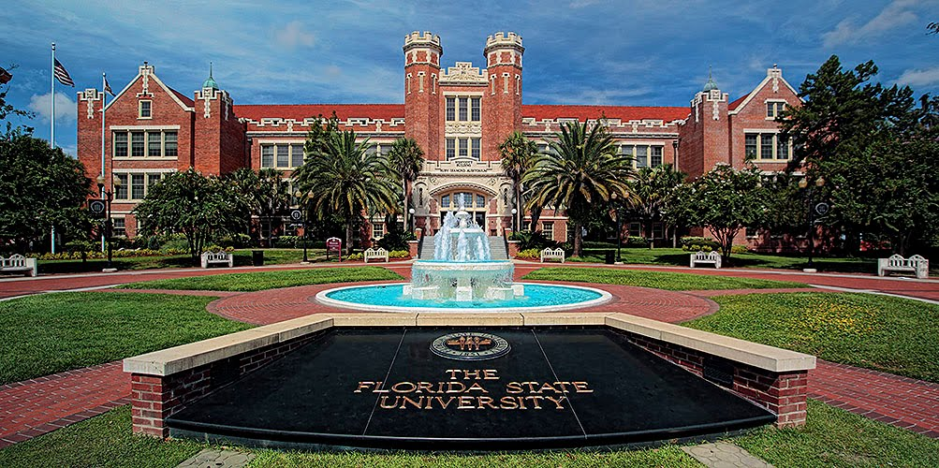
FSU Policies
Title IX Statement
Sex Discrimination &
Sexual Misconduct Policy
Equal Opportunity Statement
Equal Opportunity, Non-Discrimination, & Non-Retaliation Policy

Slide 34
What is Sexual Misconduct?
Sex/Gender Discrimination
Sexual Harassment
Gender Stereotyping/Animosity
Sexual Assault/Battery

Slide 35
Sexual Misconduct, Cont’d
New
Domestic Violence and Dating Violence
Stalking
Sexual Exploitation
Complicity

Slide 36
FSU Initiatives
FSU Campaign
Title IX Director
Jennifer Broomfield
Monitors & ensures compliance
Westcott, Suite 408
(850) 644-6271
jbroomfield@fsu.edu
http://titleix.fsu.edu/

Slide 37
FSU Initiative, Cont’d
Title IX Deputy Coordinators
Employees & 3rd Parties:
Amber M. Wagner,
HR Administrator
HR, Office of Equal Opportunity and Compliance
amwagner@fsu.edu
(850) 645-1458
Athletics: Vanessa Fuchs, Senior Associate Athletics Director vfuchs@fsu.edu (850) 644-4933 | FSU School: Megan Brink Deputy Coordinator mbrink@fsu.edu (850) 245-3894

Slide 38
Zero Tolerance Policy
FSU has a duty to:
Investigate
Eliminate
Address effects
Prevent recurrence
Applies to all students, faculty, staff, visitors, and contractors.
Applies to all programs and activities, both on and off campus and regardless of University affiliation.

Slide 39
Reporting Obligations
Encouraged reporting
All incidents
Mandatory Reporting (To Title IX Director or EOC within 2 business days)
Affected Party is a Student
Supervisor of Affected Party
Broadly defined
Affected Party is a Minor (under 18)
Florida Vulnerable Person’s Act

Slide 40
Reporting Triggers
“Knew or Should Have Known” Standard
Duty to report & respond if:
Individual mentions
Affected Party or Responding Party
You witness (see or hear)
2nd Hand Reports (co-workers/police/media)
Rumor mill

Slide 41
Who to Report to
Title IX Director
Against students
http://titleix.fsu.edu
(850) 644-6271
Equal Opportunity and Compliance (EOC)
Against staff, faculty, visitors, contractors
http://compliance.hr.fsu.edu
eoc@fsu.edu or (850) 645-6519

Slide 42
Confidential Sources
The ONLY Confidential Sources at FSU are:
FSU Victim Advocates
Mental health counselors
University Counseling Center
Employee Assistance Program
Medical Staff at Wellness Center
University Affiliated Clergy

Slide 43
Other Requests for Confidentiality
All Responsible Employees must make a report, providing name(s) and relevant details.
The Title IX Director or EOC will reach out to the Affected Party to determine next steps.
The Affected Party, at this point, may request that no action be taken and the matter remain confidential. Only the Title IX Director, or designee, is authorized to grant the request.

Slide 44
Non-Retaliation
Retaliation is prohibited against individuals who:
Make a complaint
Help someone report
Participate in an investigation
Otherwise oppose discrimination
Everyone has the right to seek help.

Slide 45
Points to Keep in Mind
When in doubt, REPORT!!!
If you think a student/subordinate is about to disclose that they have experienced sexual misconduct, remind them of your Responsible Employee status and the availability of confidential resources.
If they do disclose sexual misconduct, let them know you are required to file a Title IX report and what will happen next (i.e., the Title IX Director or EOC Investigator will contact them).
Invite the Title IX Director to conduct a Title IX training in your department.

Slide 46
Thank You!
Questions can be submitted now, or feel free to send follow-up questions or training requests to:
Jennifer Broomfield
jbroomfield@fsu.edu or 644-6271
or
Amber M. Wagner
amwagner@fsu.edu or 645-1458

Slide 47
Door Prize

Slide 48
myFSUBI Reports
Abigail Lejeune
Senior HR Specialist, Employee Data Management

Slide 49
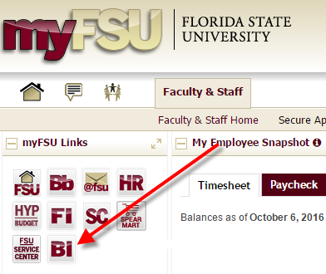
Biweekly Verification Reports
Active Employees Report
Employee Time Verification
Cost Center Report

Slide 50
Normal Payroll Schedule
Wednesday | Thursday (Last Day of Pay Period) | Friday | Monday | Tuesday
Run Actives Appointments that made deadline should appear on Actives for verification | Time Entry Deadline | Noon – Time Approval Deadline Cost Center Version 1 released | Cost Center Version 2 released 10:30am – Deadline for corrections and FSU Service Center Cases | Final Cost Center Released
http://www.hr.fsu.edu/PDF/Publications/timeandleave/NormalPayrollSchedule.pdf

Slide 51
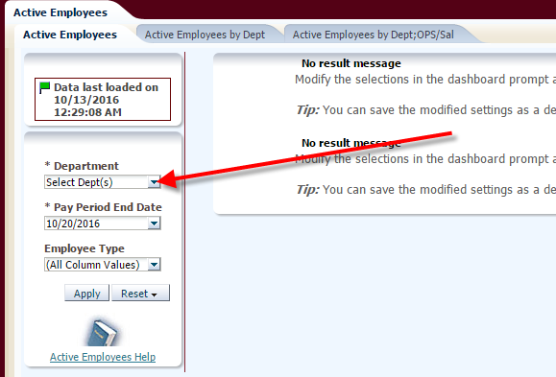
Active Employees Report
Navigation: myFSU > BI > Dashboards > HR Reports > Active Employees

Slide 52
Active Employees Report
All Active Employees
Additional Pay Supplements

Slide 53
Active Employees Report — Indicators
Yellow
Funding is ending during the current pay period
Red
Employees have moved to non-pay status during the current pay period
Green
Future job data changes (Ex: FTE, pay rate, or supervisor change)
Future funding changes

Slide 54
Active Employees Report — Timeline for Review
Can be run anytime
Data is updated nightly
Recommendation: Wednesdays prior to the time entry deadline
All appointments that made deadline should appear on the report for verification
Report discrepancies via FSU Service Center case
Case Submission Tutorial: http://servicecenter.fsu.edu/content/download/304922/2134759/file/Adding%20a%20Case%20(Self%20Service)%20MDD.pdf

Slide 55
Active Employees Report — Tips for Review
Verify that all appointment details are accurate
FTE, Compensation Rate, Job Code, Funding Details, etc.
Report discrepancies via FSU Service Center case promptly
Plan for upcoming appointment actions required
Ex: ePAF to extend funding period
Training Guide: http://hr.fsu.edu/PDF/Publications/training/RunningtheActiveEmployeesReport.pdf

Slide 56
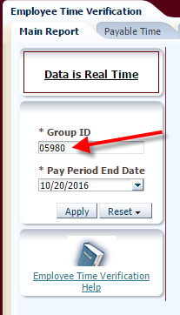
Employee Time Verification Report
Navigation: myFSU > BI > Dashboards > HR Reports > Employee Time Verification
Use Time Approval Group ID
Group List – Group ID Lookup

Slide 57
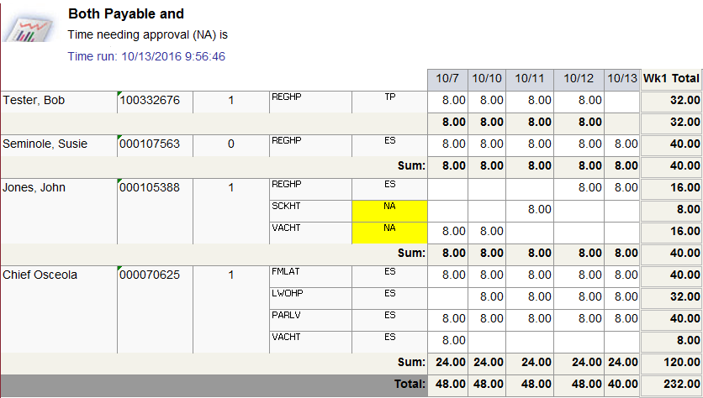
Employee Time Verification Report — Report Options
Main Report
Payable Time
Reported Time
Status:
TP (Taken by Payroll)
ES (Estimated)
NA (Needs Approval)

Slide 58
Time Prior Pay Period and Future Dated Time
Shows time changes in prior pay periods and future dated time entries.

Slide 59
Payable Time with Est $$$
Replaces payable time status with estimated gross pay.

Slide 60
Employee Time Verification Report — Timeline for Review
Can be run anytime
Real time data
Run after time entry deadlines to verify employee time entry and supervisor approval
Use to compare to Cost Center Data during payroll processing

Slide 61
Employee Time Verification Report — Tips for Review
Entries that Need Approval are highlighted in yellow.
Managers can review to check for appointment data and verify time entry.
Identifies those without time entries for reminders.
Training Guide: http://omni.training.fsu.edu/content/download/5639/36605

Slide 62
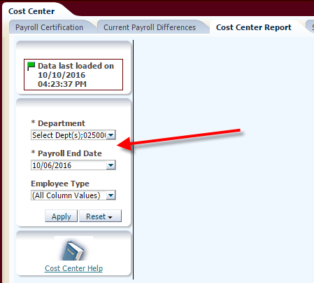
Cost Center Report
Navigation: myFSU > BI > Dashboards > HR Reports > Cost Center

Slide 63
Cost Center Report — Timeline
Thursday (Last Day of Pay Period) | Friday | Monday | Tuesday
Time Entry Deadline | Noon – Time Approval Deadline Cost Center Version 1 released (approximately 2pm) | Cost Center Version 2 released (approximately 8am) 10:30am Deadline for corrections and FSU Service Center Cases | Final Cost Center Released

Slide 64
Cost Center Report — Indicators
Red – Employee was on the preceding cost center report and is no longer present in the same status.
Green – Employee was not present on preceding cost center report or is now present in a different status.
Yellow – Employee was on previous cost center report, but hours or earnings have changed.
Red arrows – Decrease
Blue arrows – Increase

Slide 65
Cost Center Report — Options
Current Run vs. Previous Final
Compares the current pay period’s most recent calculation to final for the prior payroll period.
Summary by Earnings Code
Shows total number of hours and earnings for each earnings code
Compares totals to last payroll run
Current Payroll Differences
Version 1 – Current pay period’s initial calculation to prior period’s final
Version 2 – Comparison between version 1 and version 2
Final Version – Comparison between version 2 and final

Slide 66
Cost Center Report — Payroll Certification
Displays final payroll costs once payroll is confirmed
Prior to paycheck issue date, get Dean, Director, or Department Head signature.
Keep in department files.
If corrections are still required, note case number on report.

Slide 67
Cost Center Report — Tips for Review
Report shows all current charges, corrections made to prior pay periods will appear on the report.
Check Employee Time Verification and Review Paycheck Summary for more details.
Time entries not approved prior to payroll calculation will not appear on the report.
10:30am Monday – Deadline for FSU Service Center Cases and time corrections
Training Guide: http://hr.fsu.edu/PDF/Publications/training/RunningtheCostCenterReport.pdf

Slide 68
Upcoming Accelerated Payrolls
Pay Period J (10/21/16-11/03/16) –1 day early
Time entry due: 11/02/16; Approval due: 11/3/2016
Pay Period K (11/04/16-11/17/16 ) – 2 days early
Time entry due: 11/15/16; Approval due: 11/16/2016
Pay Period M (12/02/16-12/15/16) – 1 day early
Time entry due: 12/14/16; Approval due: 12/15/16

Slide 69
Upcoming Accelerated Payrolls
Pay Period N (12/16/16- 12/29/16) – 6 business days early
Appointment paperwork deadline: 12/02/16
Time entry due: 12/21/16
Approval due: 10am on 12/22/2016
Preliminary Cost Center issued: 12pm on 12/22/16
Service Center Case deadline: 4pm on 12/22/16
Final Cost Center issued: 12/23/16

Slide 70
Payroll Updates & Reminders
Margaret Partain, Evelynn Steffen, & Rhonda Reynolds
Payroll Services

Slide 71
Payroll Services - Tax
Margaret Partain and Evelynn Steffen
Nonresident Alien Tax Specialists

Slide 72
Nonresident Aliens
Non-employee payments to foreign nationals
Contact Payroll-Tax (CTL-Payroll-Tax@admin.fsu.edu)
New class available in spring
NRA’s entering and/or leaving the U.S.?
Notify Payroll-Tax (CTL-Payroll-Tax@admin.fsu.edu)

Slide 73
Year-End Prep
Update mailing address in OMNI HR by 1/2/17 to be used on 2016 W2 form.
Update preferred email address to receive important tax related email notifications.
Consent to receive W2 form electronically
Terminated employees have access to retrieve W2 information through May 1st of the calendar year following the year of termination

Slide 74
Payroll Services - Accounting
Rhonda Reynolds
Accounting Specialist

Slide 75
eRDFs (Electronic Retroactive Distribution of Funding)
Payroll Accounting is launching an electronic form and approval process to replace the Retro-Distribution of Funding (RDF) paper form.
The new process will improve
efficiency in the workflow approval process
accuracy in the completion of the form
initiative to go paperless

Slide 76
eRDFs (Electronic Retroactive Distribution of Funding)
The user will select the employee ID, Record #, and dates affected by the eRDF and the form will populate the total wages involved with the transaction.
The user will enter the new funding source and percentage and/or amount of change.

Slide 77
eRDFs (Electronic Retroactive Distribution of Funding)

Slide 78
eRDFs (Electronic Retroactive Distribution of Funding)

Slide 79
eRDFs (Electronic Retroactive Distribution of Funding)
The form will follow the same approval process as ePAF.

Slide 80
eRDFs (Electronic Retroactive Distribution of Funding)
Users will need one of the following security roles to have the ability to enter and/or approve eRDF
FSU_PR_DEPARTMENT_USER (enter or view)
FSU_SS_MANAGER (approve)
FSU_HR_SRESEARCH (Sponsored Research use only) (approve)
New Role
FSU_PR_DISTRIB_USER (enter or view)

Slide 81
eRDFs (Electronic Retroactive Distribution of Funding)
There will be an email announcing the go-live date along with a job aid.
Payroll will offer a transition period where paper forms will continue to be accepted.
Training Class will be offered in early 2017.

Slide 82
Payroll Encumbrance Calculation Enhancement
Last fiscal year, the payroll encumbrance calculations were enhanced to include the following:
The encumbrance process uses the funding end date of payroll “Z” for non-C&G sources and funding end date for C&G sources.
Non-C&G are no longer encumbered through June 30th of each fiscal year.
Social Security taxes are encumbered using the annual limits for each year associated within the fiscal year.

Slide 83
Payroll Encumbrance Calculation Enhancement
Future hired employees are included in the encumbrance calculations.
Future salary changes on job data are included in the encumbrances.
Recurring “Additional Pays” are now being encumbered.

Slide 84
Payroll Encumbrance Calculation Enhancement
The final changes to the encumbrance enhancement will go live in November
The encumbrance calculation for benefits no longer uses the deduction amount on paycheck, but uses the benefit rate tables for each benefit code.
The process will continue to use the deduction amounts on paychecks for part-time employees.
The calculation of deductions for 9/10 month employees includes the seven double deduction pay periods but does not include any additional pay periods due to the funding end date.

Slide 85
Payroll Accounting
For questions related to the eRDF or encumbrance processes, please email Payroll Accounting at CTL-Payroll-Acctg or contact
Debbie Dupree 644-9431
Rhonda Reynolds 644-9401
Beverly Miller 645-2772

Slide 86
Employment & Recruitment Update
Andrew Kapec
Senior HR Specialist, Employment & Recruitment

Slide 87
Employment of Relatives (Nepotism) Policy
The new policy applies to all employees – USPS, A&P, Faculty, and OPS.
Prohibits the employment of relatives in positions where they will have a supervisory relationship with a relative.
What is a supervisory relationship?
Direct supervisor
Anywhere in the chain-of-command
Includes dotted line reporting.
Prohibits permitting relatives to control employment and payroll related activities for individuals with whom they are related.

Slide 88
Employment of Relatives (Nepotism) Policy
Exceptions to the policy must be requested by submitting an Employment of Relatives (Nepotism) Policy Form to Human Resources.
What is a “Relative”?
Related by blood, adoption, marriage (“in-laws” or “step”), or other legal action.
spouses
parents
grandparents
children
grand-children
Siblings
Aunts/uncles
Nieces/nephews

Slide 89
Recruiting Improvements
Ability for third parties to submit letters of recommendation via OMNI HR on behalf of applicants.
- Applicant's View

Slide 90
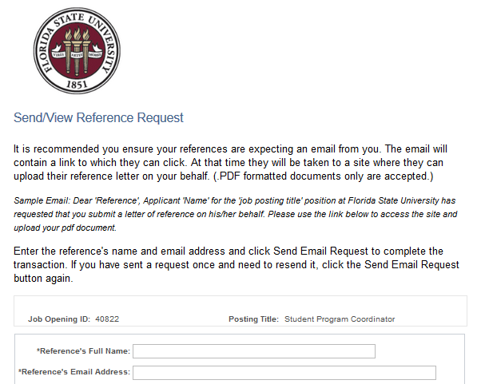

Slide 91
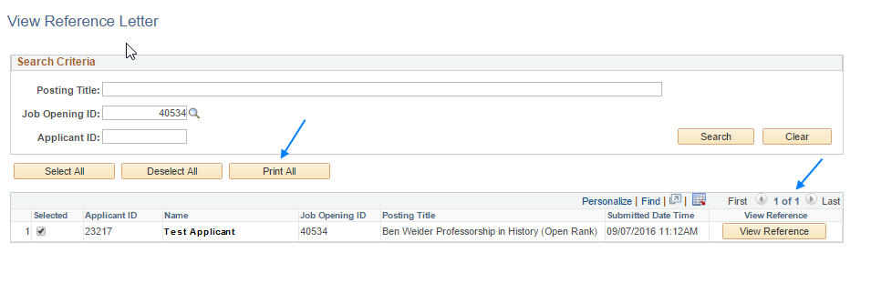
Recruiting Improvements
Letters of Recommendation
- Department's View

Slide 92
Criminal History Background Checks
Background Check Portal Improvements
Automatic emailing
Request Forms to HR-ERS for initiation
Questionnaires to the department and position supervisor for approval
Questionnaires now only require supervisor signature
New Unadvertised Questionnaire for multiple candidates

Slide 93
Criminal History Background Checks
All background check forms should be completed in the Portal
Questionnaires for single candidates
Questionnaires for multiple candidates (GA & OPS only)
Request Forms

Slide 94
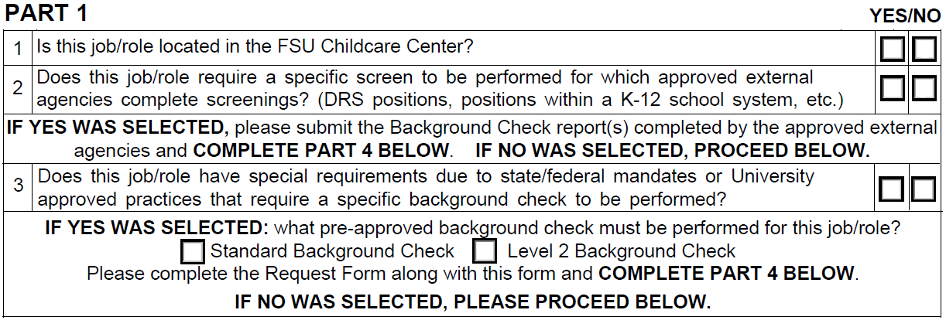
Criminal History Background Checks
Overview of new “Specialized” questions on Questionnaire

Slide 95
Criminal History Background Checks
Background checks are initiated only after the signed Questionnaire is received
Timing
Approval to proceed with hires must be received from HR-ERS before:
Offer of Employment (Staff, OPS)
Beginning work (Faculty/GAs)

Slide 96
Break

Slide 97
Essential Piece Award
Renisha Gibbs
Assistant Vice President for Human Resources
Finance & Administration Chief of Staff

Slide 98
Essential Piece Award
She is very helpful when working with Human Resources, and makes it her priority to follow-up when additional information is requested.
She is very dependable, thorough, and exhibits a “can do” attitude about the work she performs.
Not only is she an invaluable department representative from the HR side, I know her department values the work she consistently performs for them.
Her department recently went through a re-organization. This required many position updates and salary analyses. Many of these changes affected FLSA classifications and she was able to enter the ePafs and obtain employment contracts for the affected employees in a timely manner.
She makes our jobs easier!

Slide 99
Krista Frunzi Administrative Specialist, WFSU
Fall 2016 Outstanding Department Representative and Essential Piece Award Winner

Slide 100
Training Center Renovations
Sandra Dixon
Associate Director, Training and Organizational Development

Slide 101
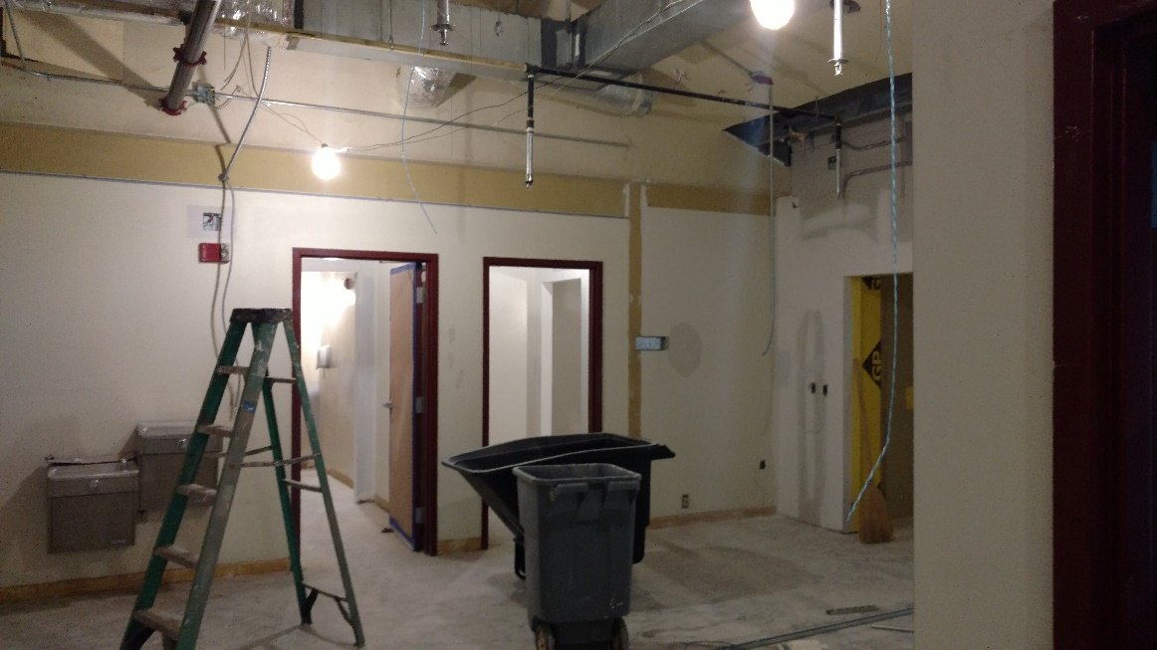
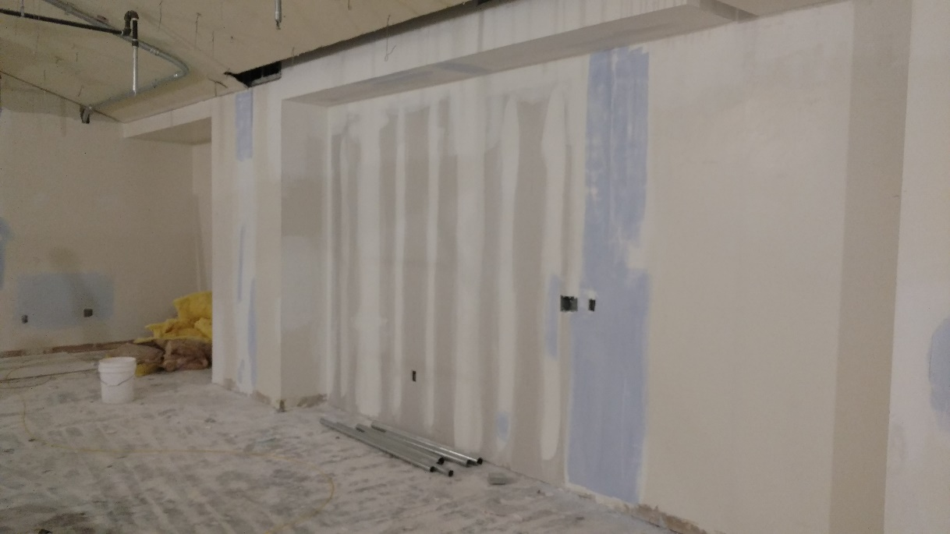
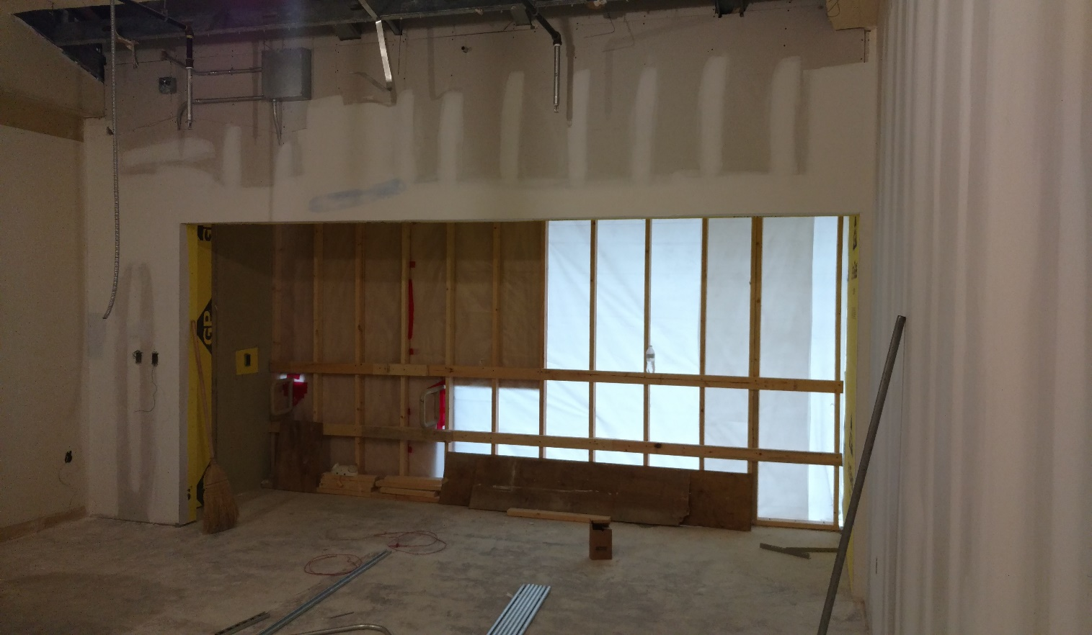
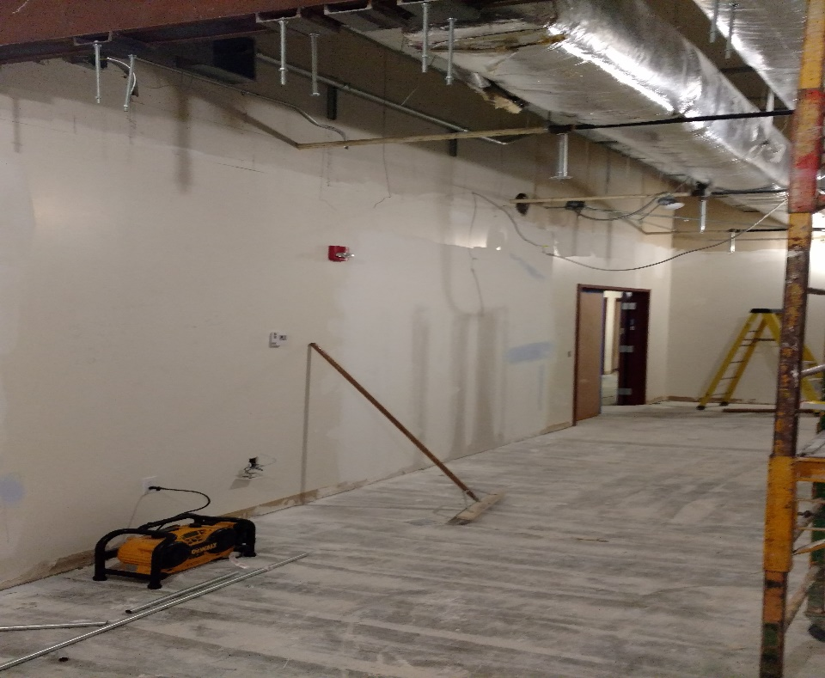
Training and Organizational Development
Summer 2016

Slide 102
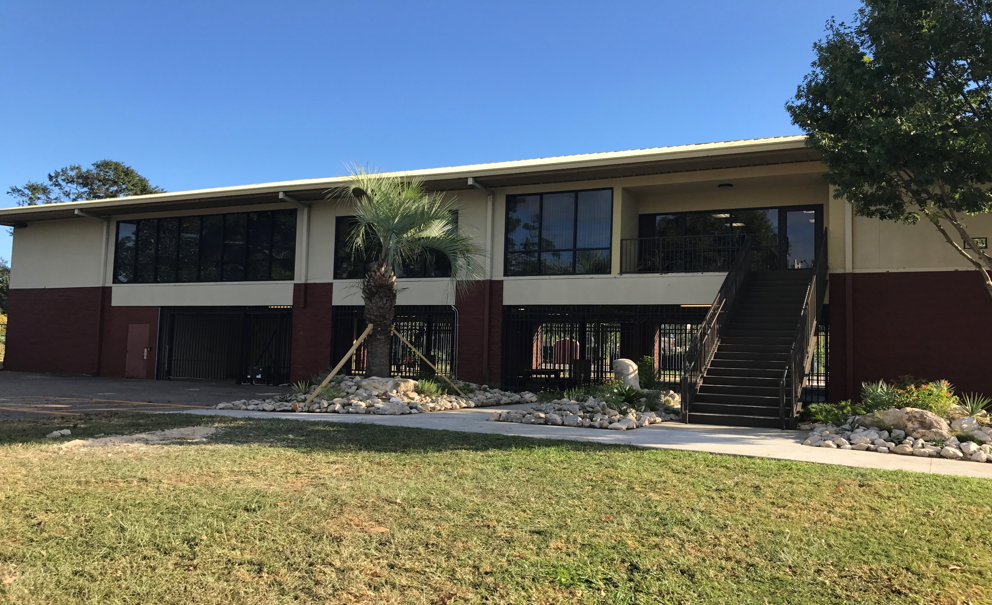
Training and Organizational Development
We have a brand new look!

Slide 103
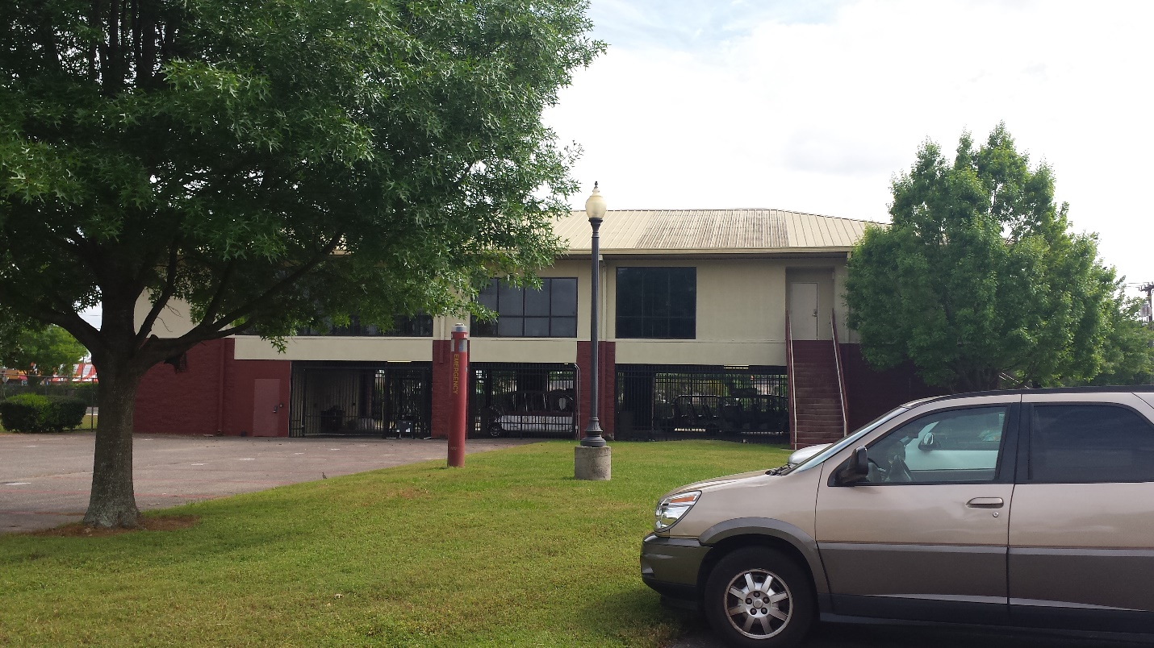
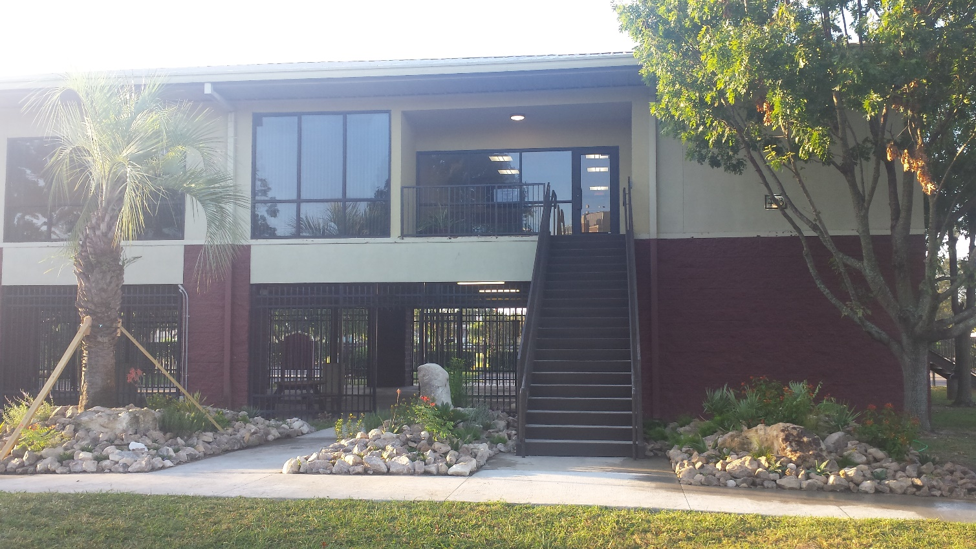
Training and Organizational Development Our recently-remodeled training center boasts more than a new entrance
before
after

Slide 104
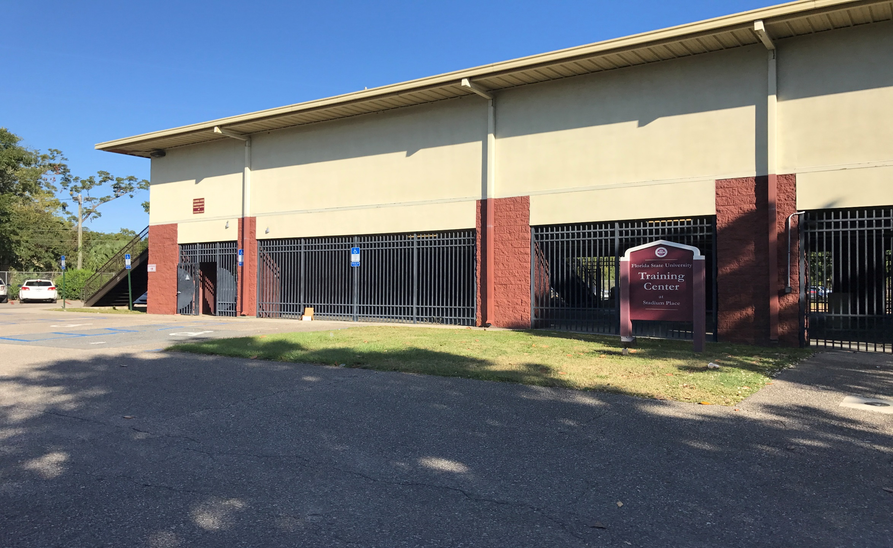
Training and Organizational Development Our recently-remodeled training center boasts more than a new entrance

Slide 105
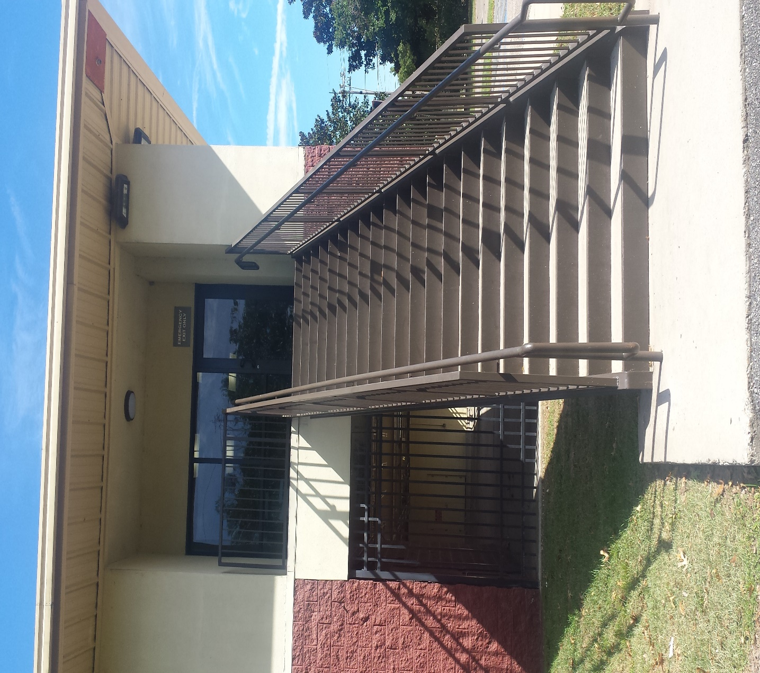
Training and Organizational Development Our recently-remodeled training center boasts more than a new entrance

Slide 106
Training and Organizational Development We are equipped with state-of-the-art technology and a new approach to training

Slide 107
Training and Organizational Development
Expanded Lobby Area
Notes:
Insert Reception Area

Slide 108
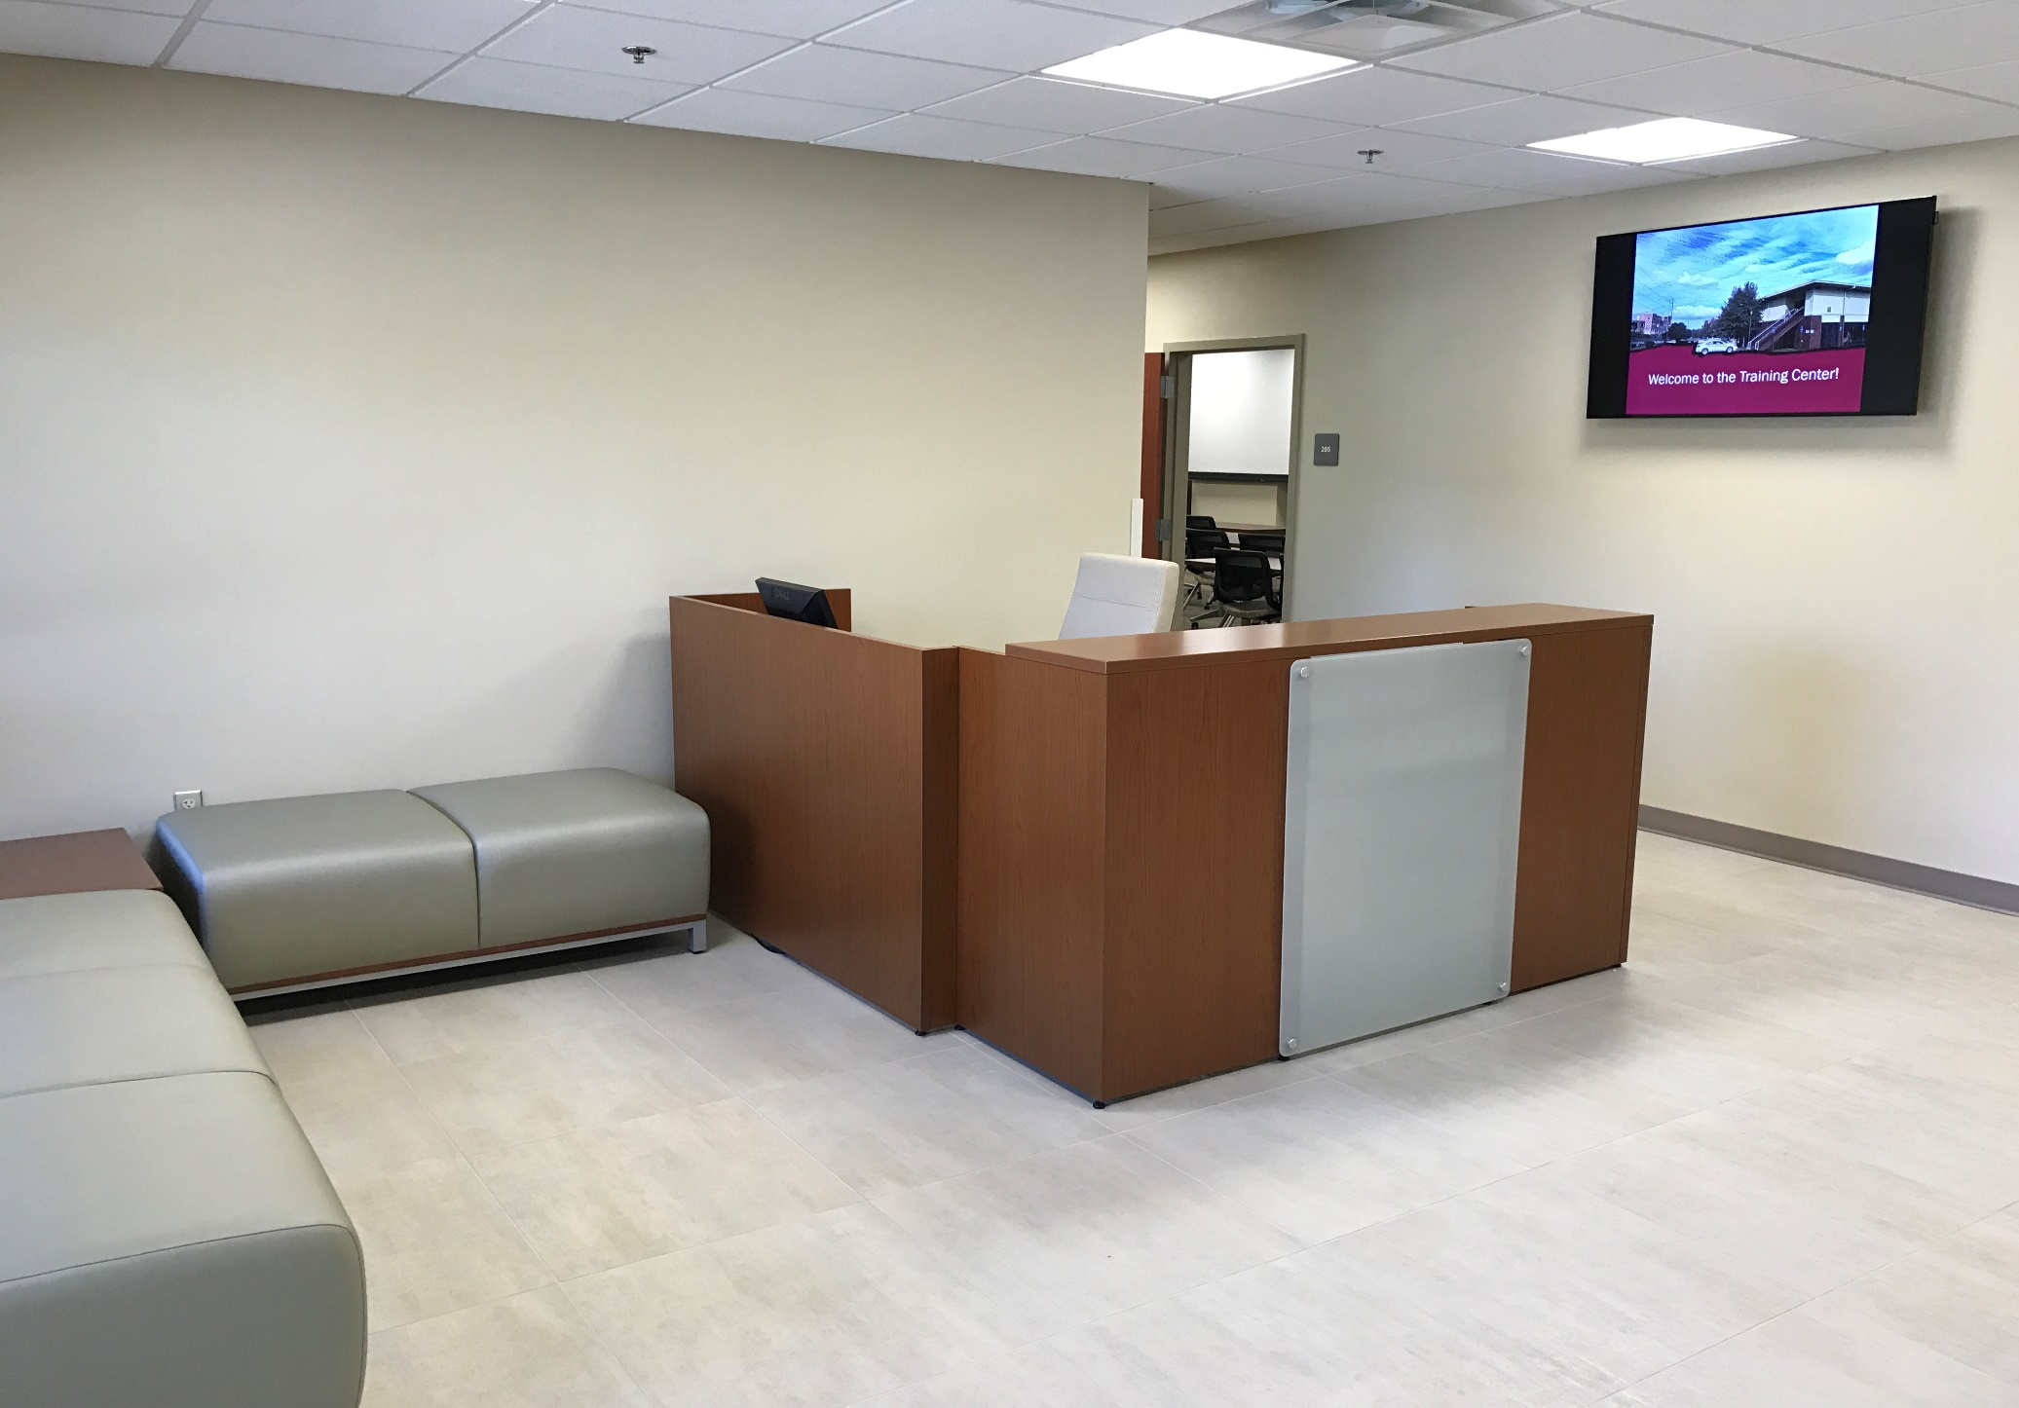
Training and Organizational Development Expanded Lobby Area

Slide 109
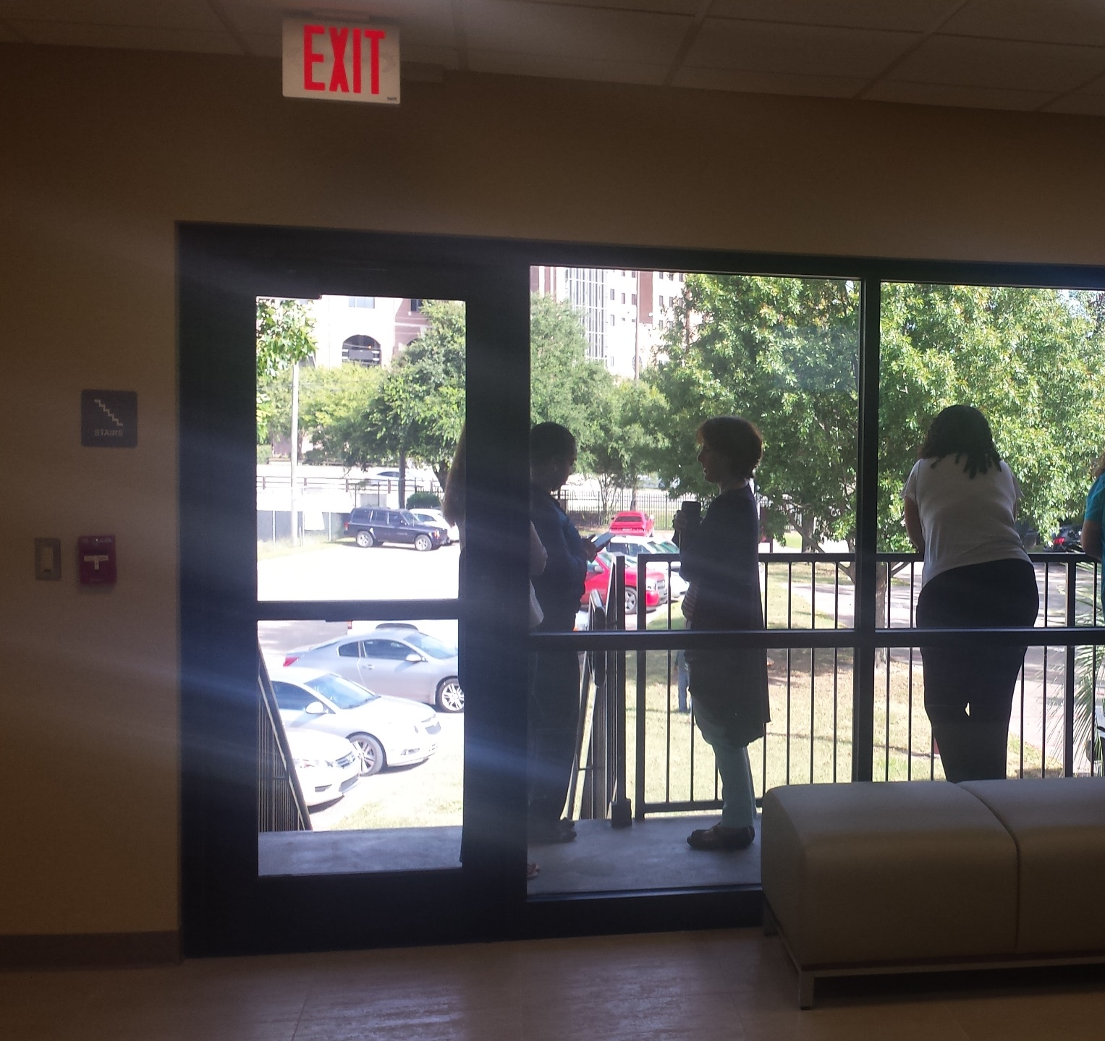
Training and Organizational Development Enjoy a break on the balcony

Slide 110
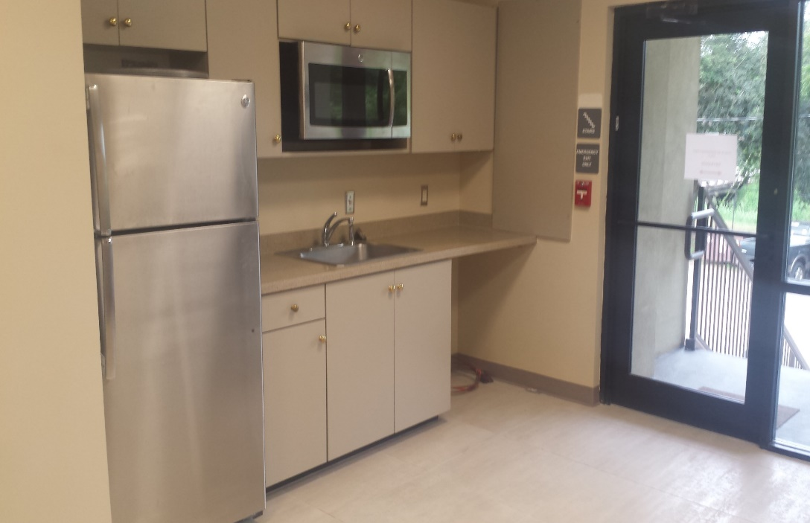
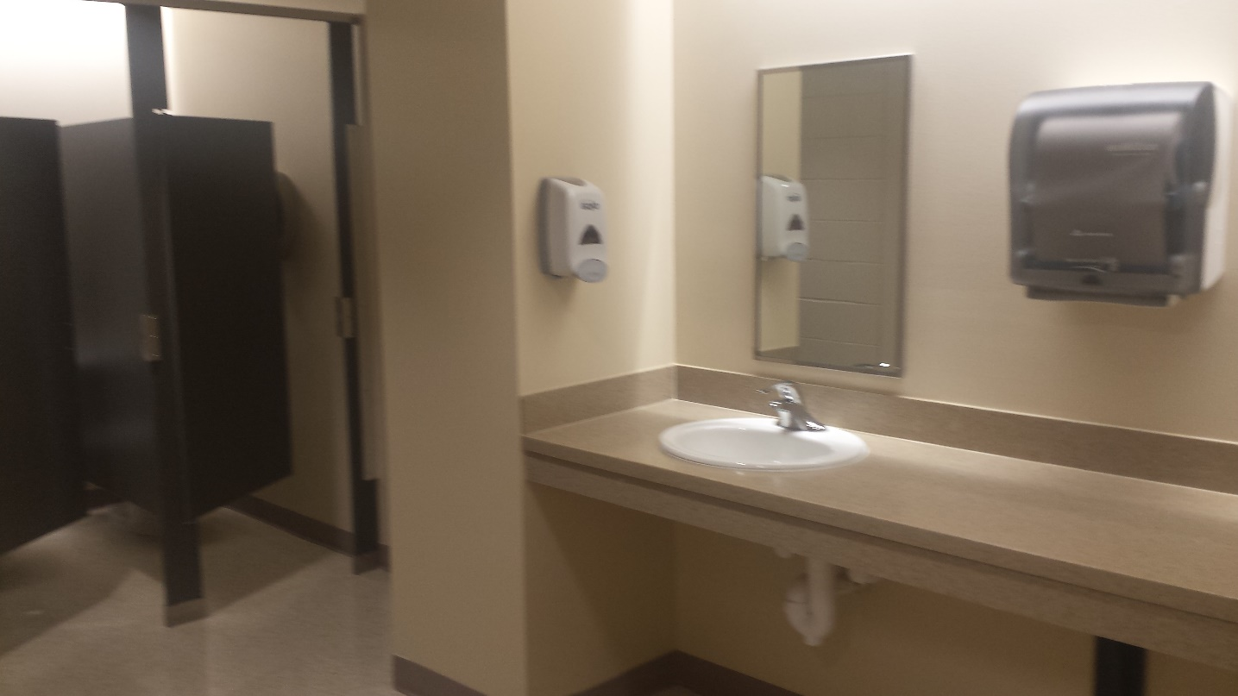
Training and Organizational Development Updated Amenities

Slide 111
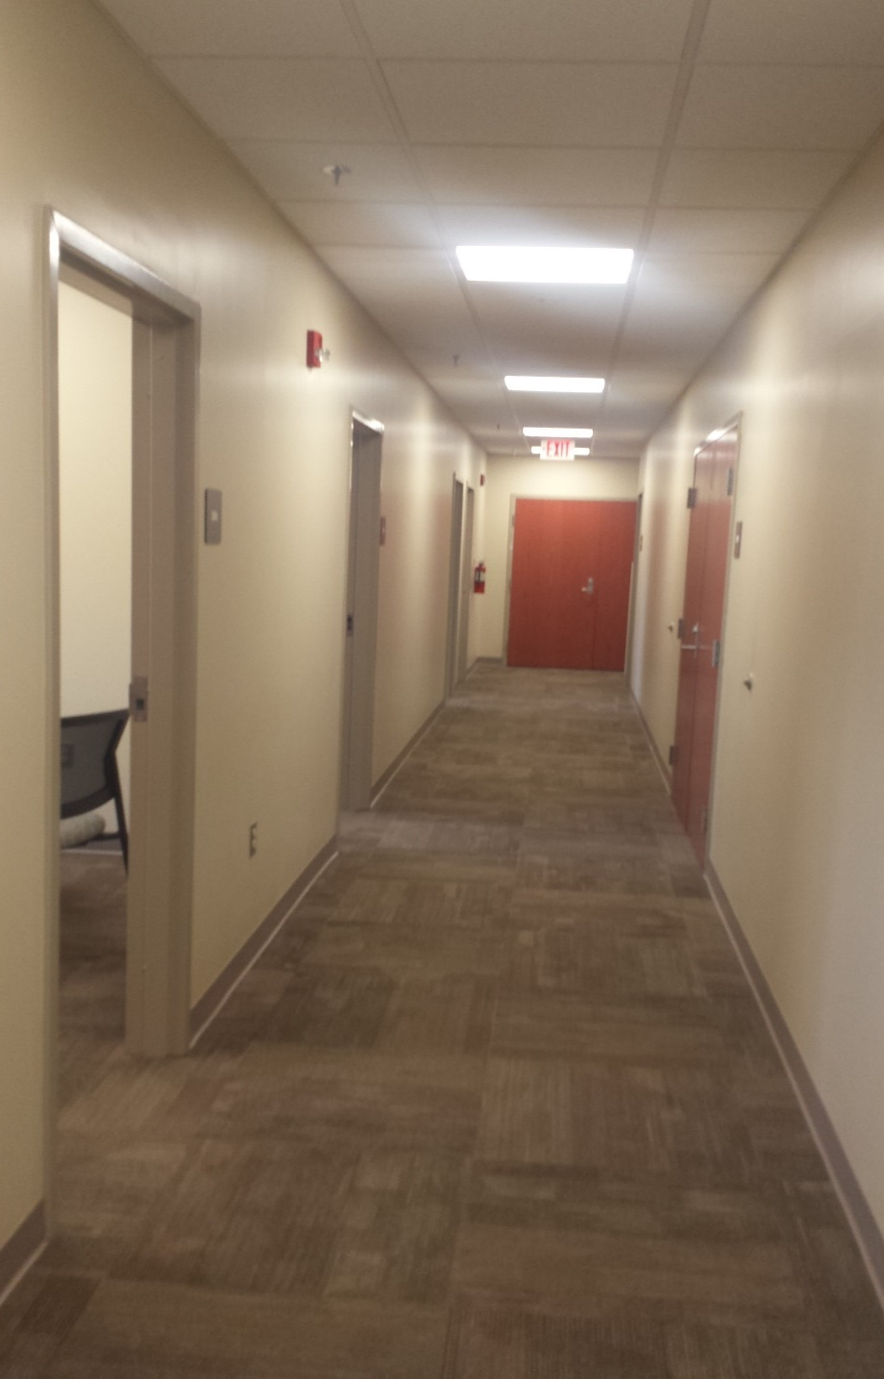
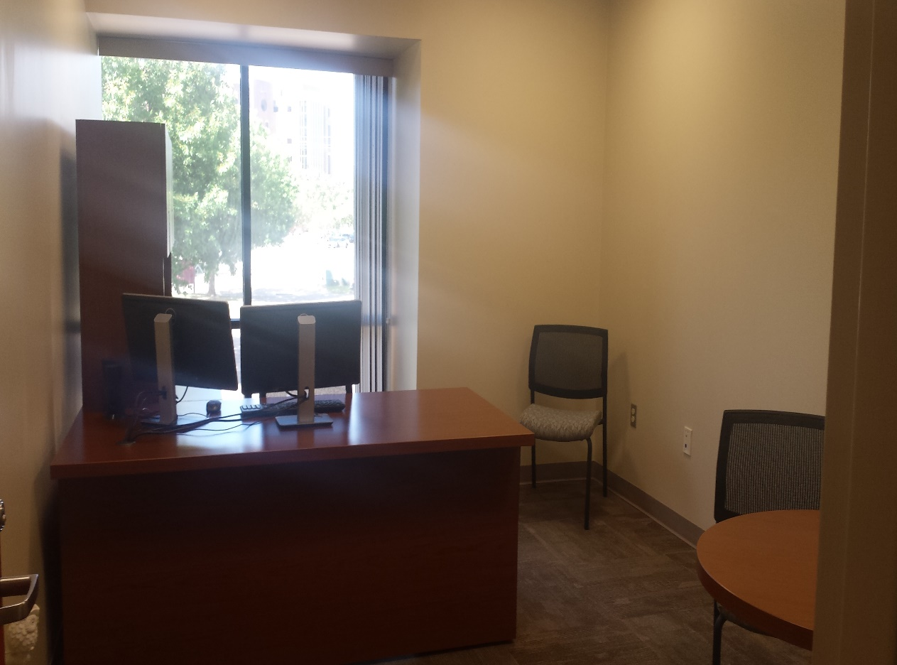
Training and Organizational Development
Fresh Finishes

Slide 112
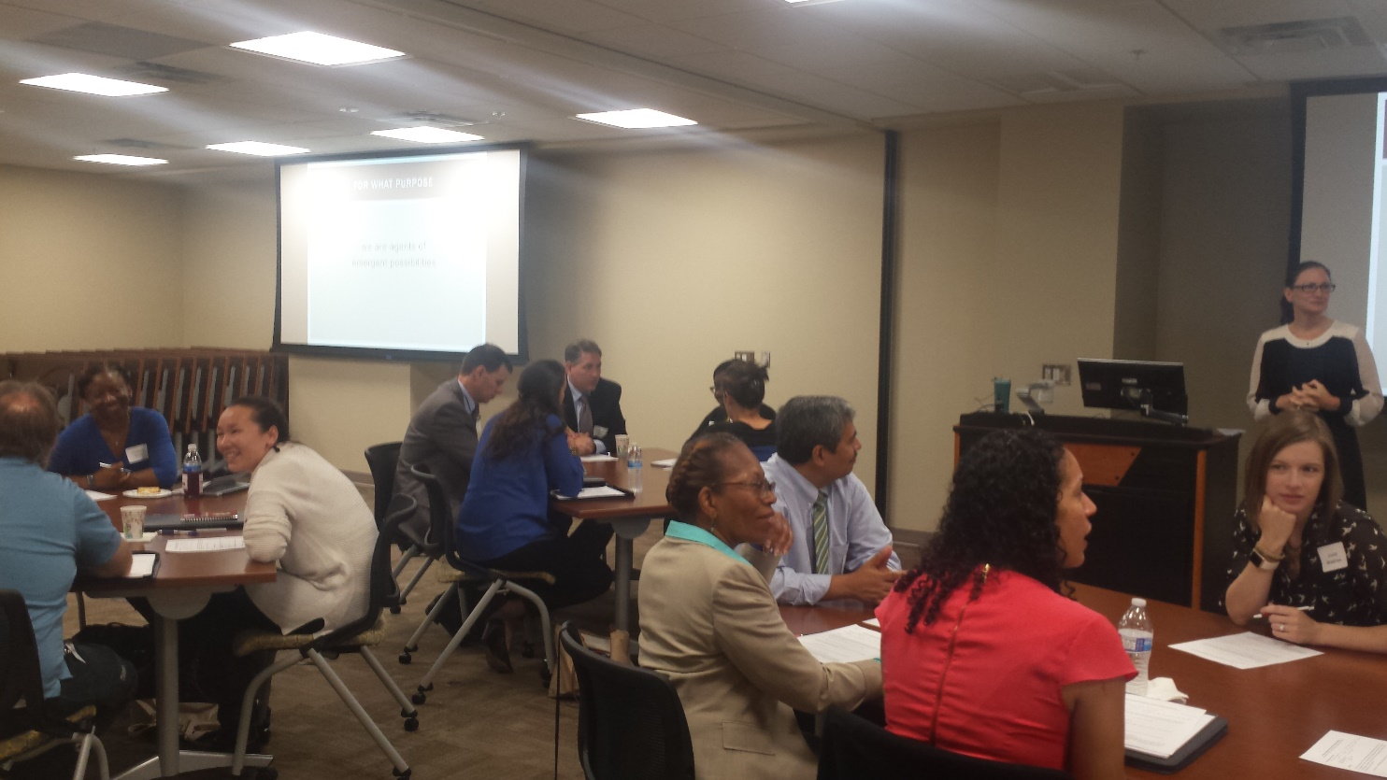
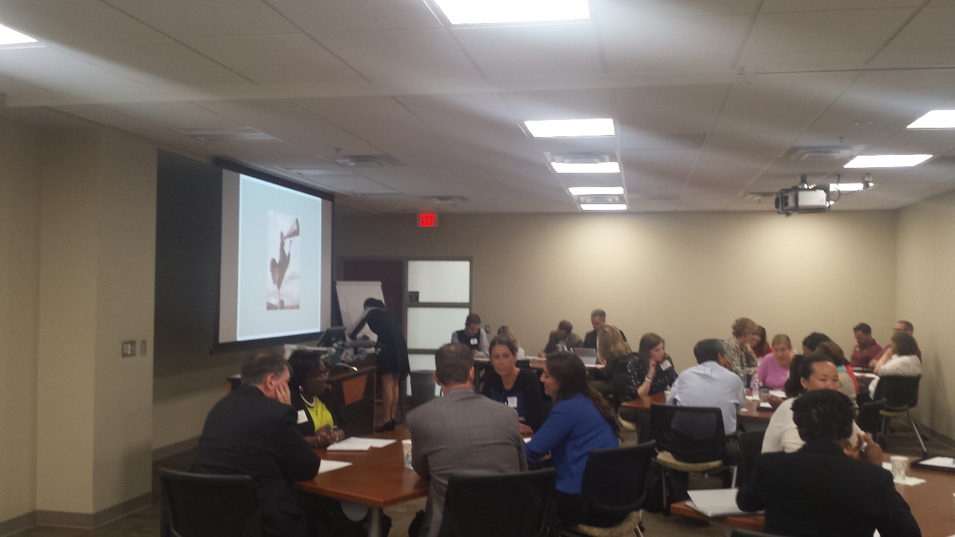
Training and Organizational Development
We offer free classes and workshops
both face-to-face
and online
on a variety
of topics
to help you grow
and excel
in your career
at FSU

Slide 113
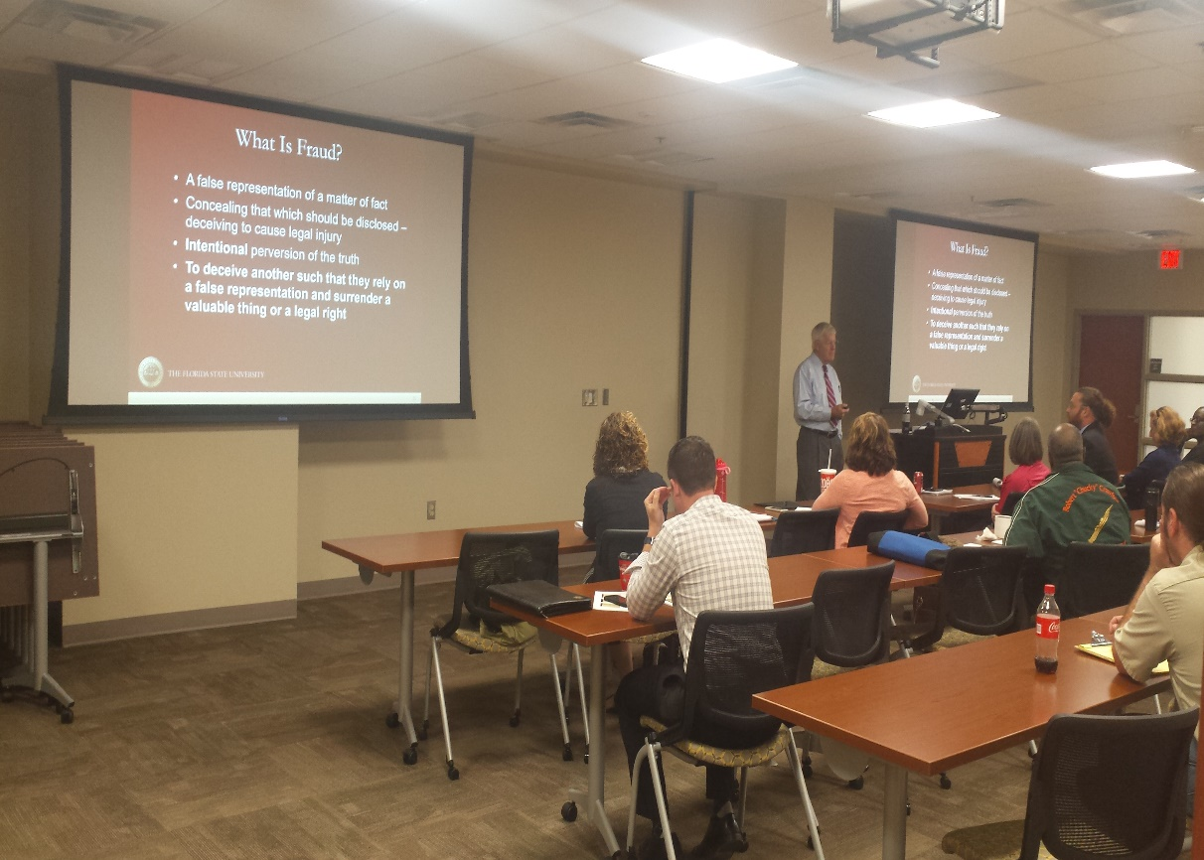
Training and Organizational Development We offer free classes and workshops
Explore Our Certificate Training Series:
Customer Service
Frontline Leadership
HR Department Representative
Time and Labor Representative
Sponsored Research Admin
Financial Representative
Diversity and Inclusion
Global Partners
Or Individual Course offerings on:
FSU Systems
Compliance & Org Development
Personal Development
Customer Service

Slide 114
Training and Organizational Development
Register for training at my.fsu.edu
Visit our online course catalog
Call us: (850) 645-8724
email us: training@fsu.edu
Come. Discover.
hr.fsu.edu/train

Slide 115
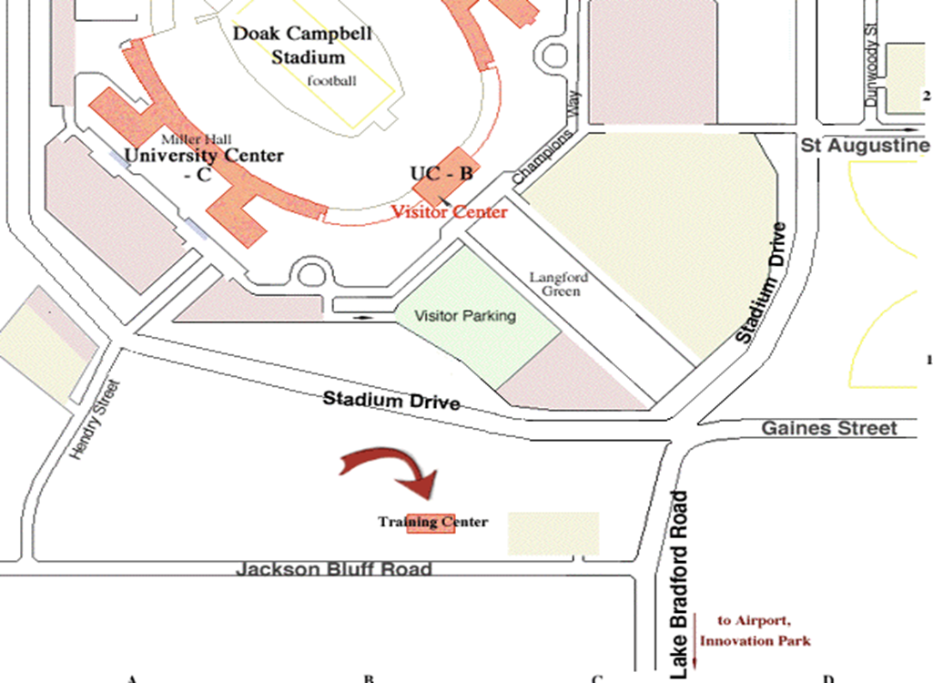
Training and Organizational Development
Find Us
493 Stadium Drive or
1300 Jackson Bluff

Slide 116
Training and Organizational Development
Meet Our Staff
Sandra Dixon, Associate Director
Michelle Douglas, Director, Organizational Development & Equal Opportunity Compliance
Janet Fryman, Training Coordinator
Sarah Hubbard, Training Specialist

Slide 117
FSU Mobile
Phaedra Harris
Director, HR Operations

Slide 118
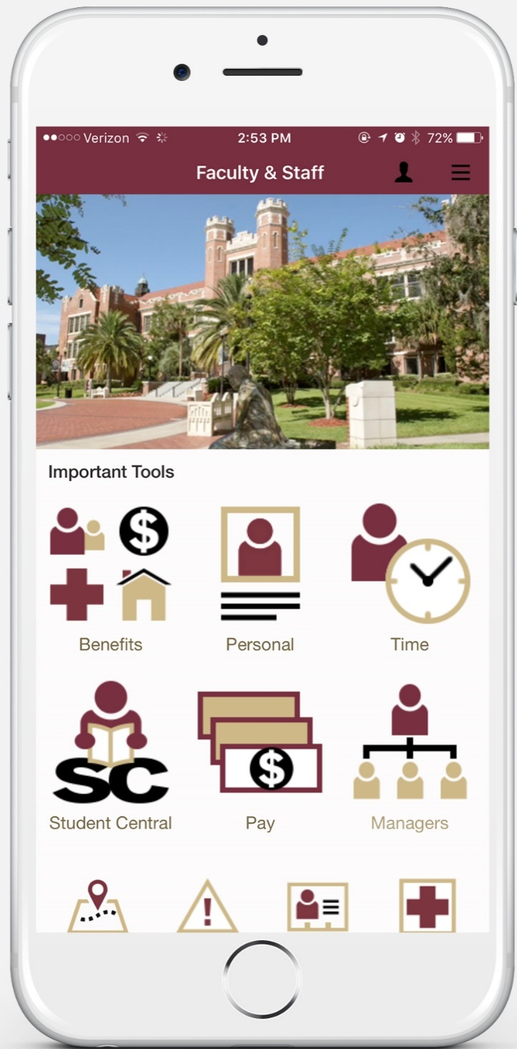
The latest round of enhancements to the myFSU Mobile app is part of Florida State University’s Digital Campus Initiative.
The initiative aims to make university systems more accessible and useful for day-to-day functions, enabling the university community to securely access personalized information from any mobile device.
To access OMNI HR employee and manager self-service features within myFSU Mobile, employees simply select the Faculty & Staff view by tapping the person icon at the top of the screen.
Using the app, employees can visit self service menus including enter and approve time, view paychecks, check leave balances, update personal info, and more.

Slide 119
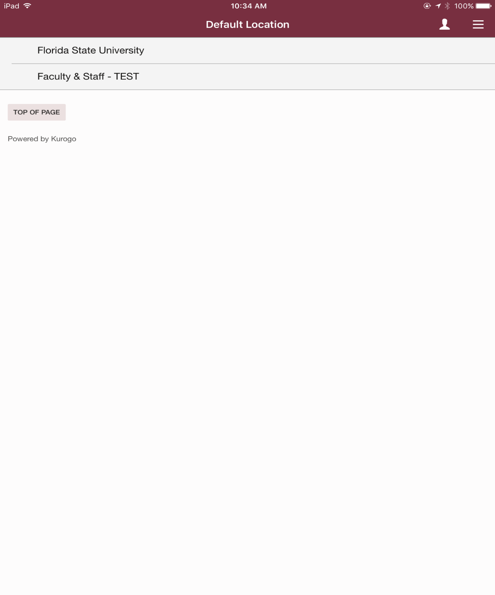
Default Location
Faculty & Staff

Slide 120
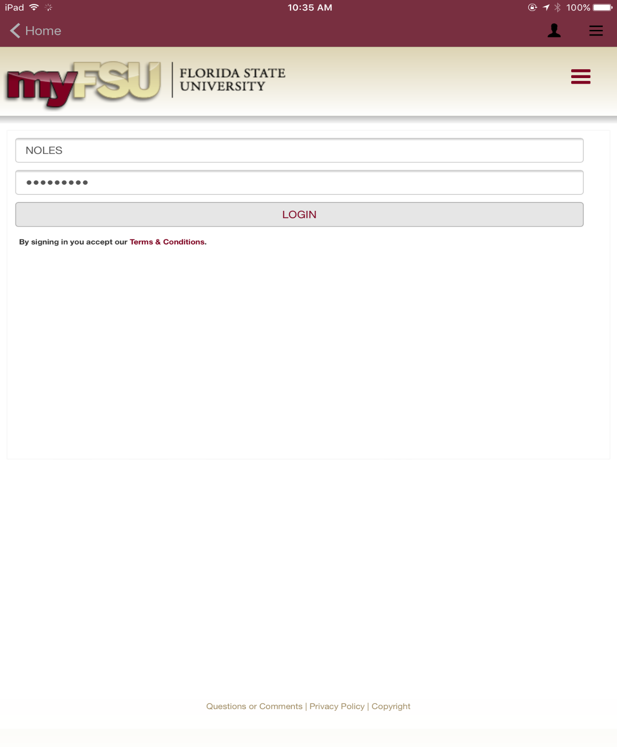
LOGIN
Use FSUID and Password

Slide 121
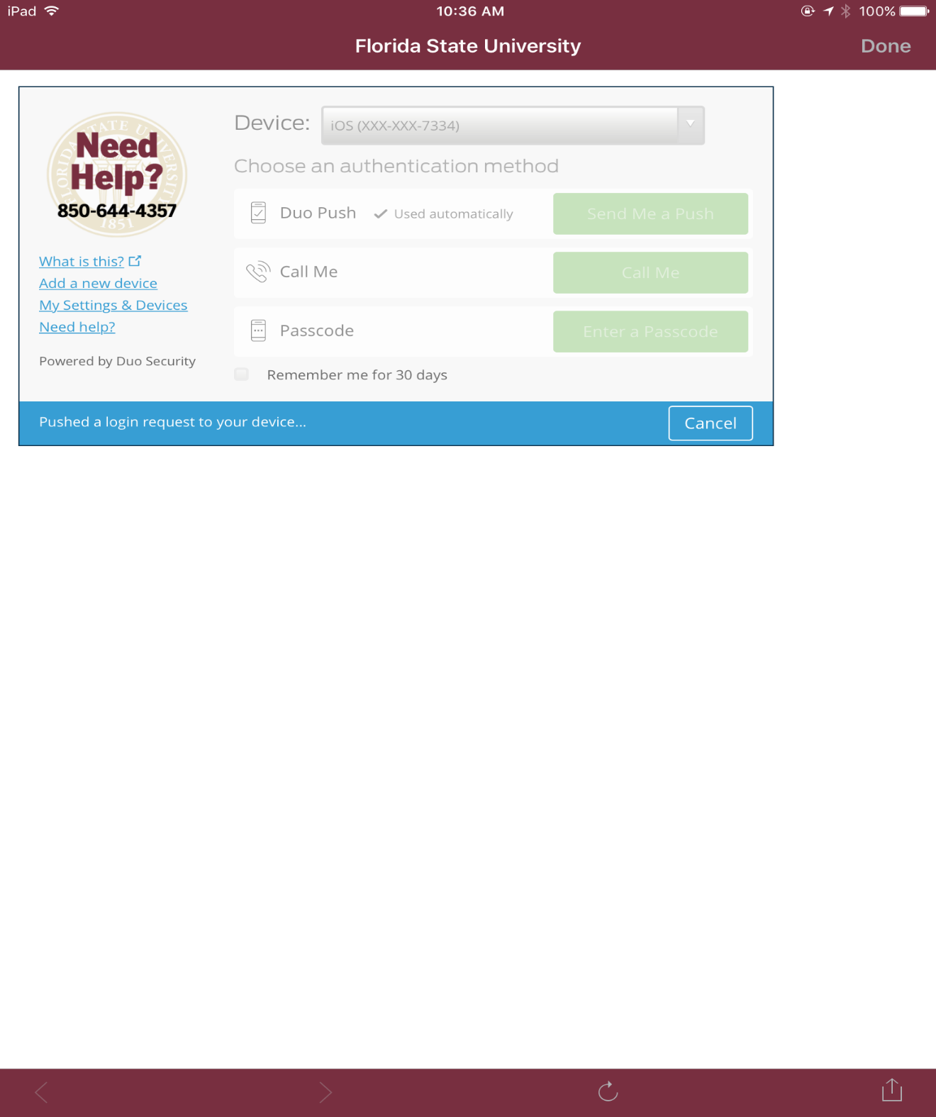
DUO Authentication
Regular process for validation
*Don’t forget
“Remember me”

Slide 122
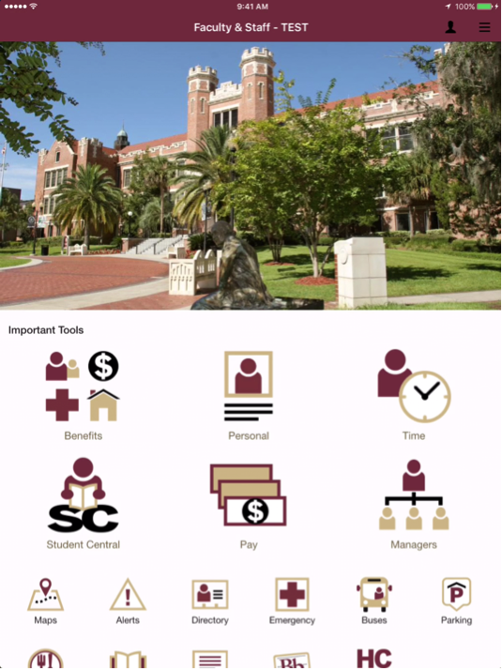
Faculty & Staff
Main Screen

Slide 123
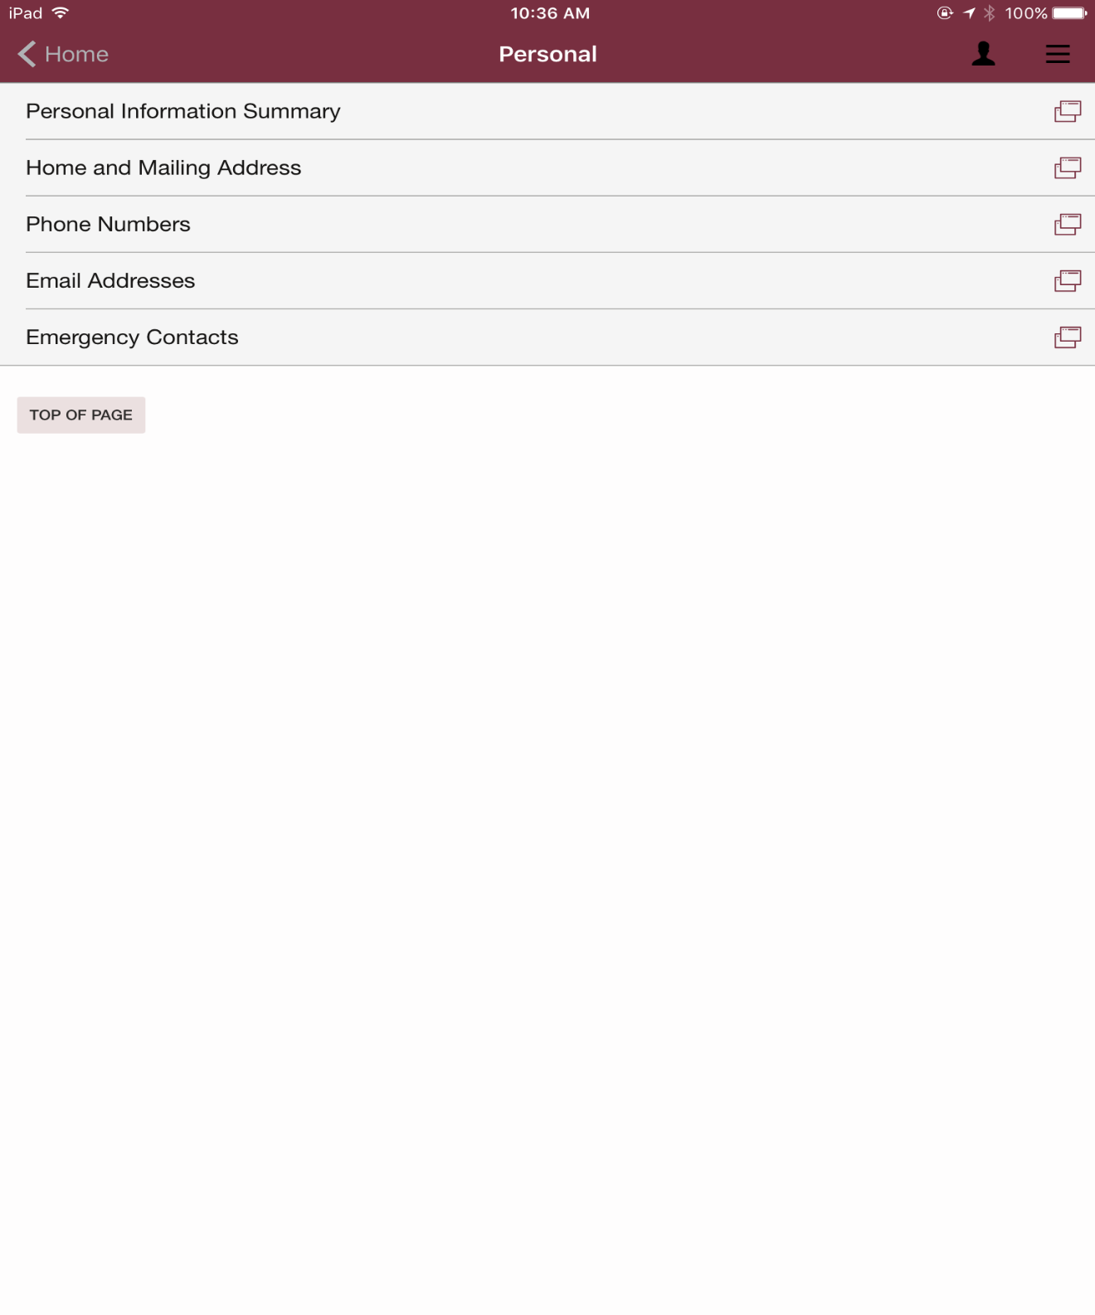
Personal Information
Same menu options as OMNI HR

Slide 124
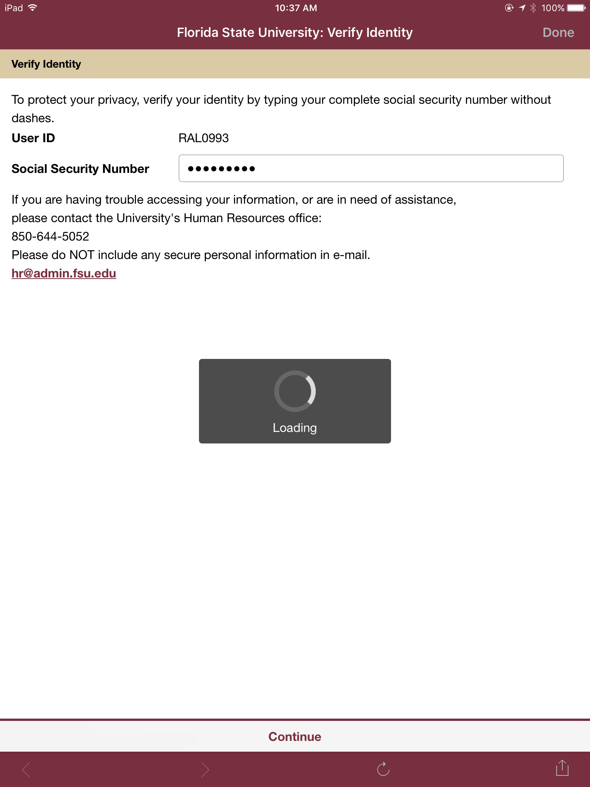
To view information, you will be required to verify your identity by entering
your
SSN.

Slide 125
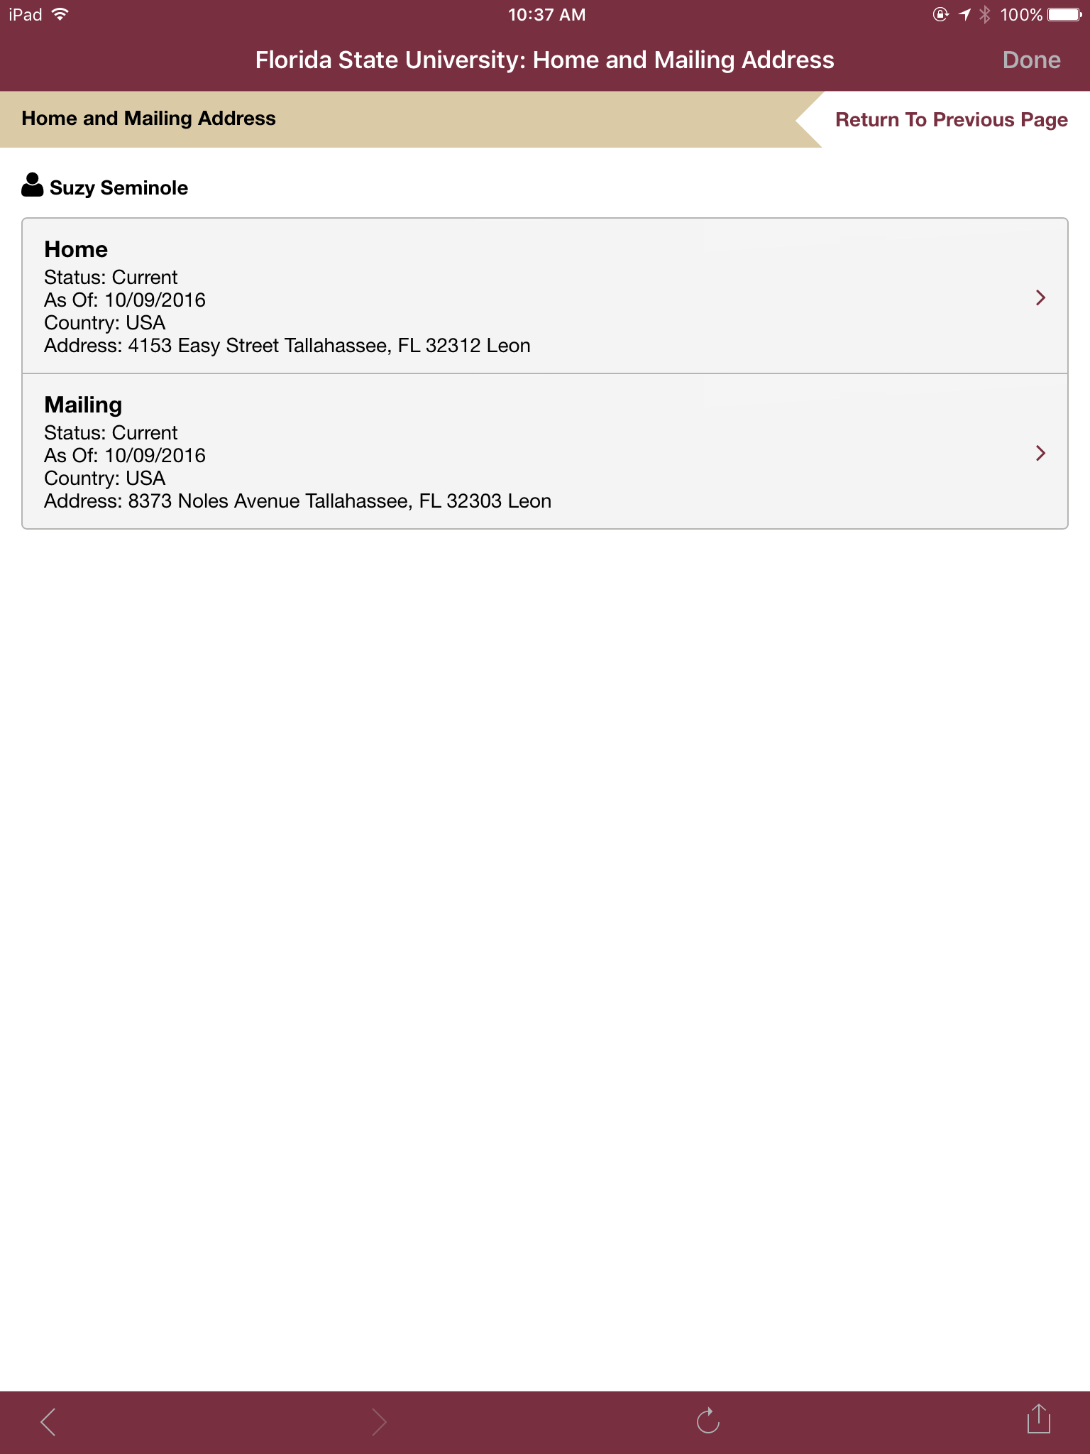
Home and Mailing Address

Slide 126
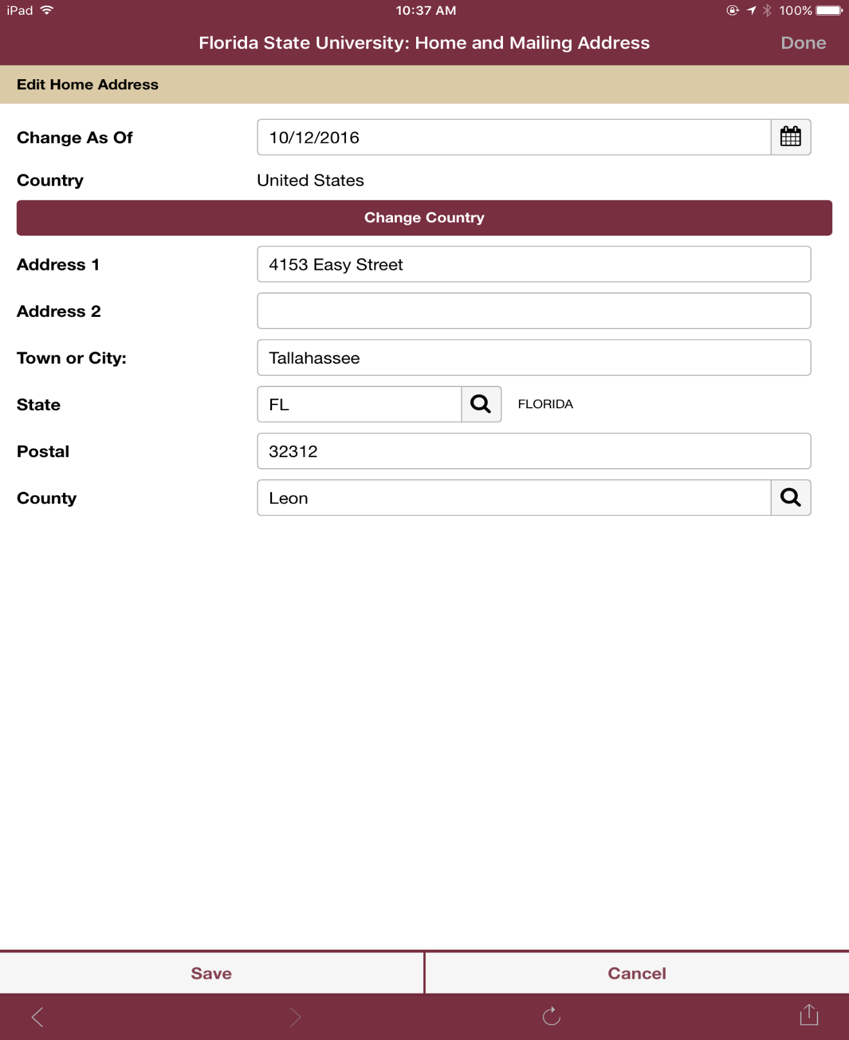
Edit Home or Mailing Address

Slide 127
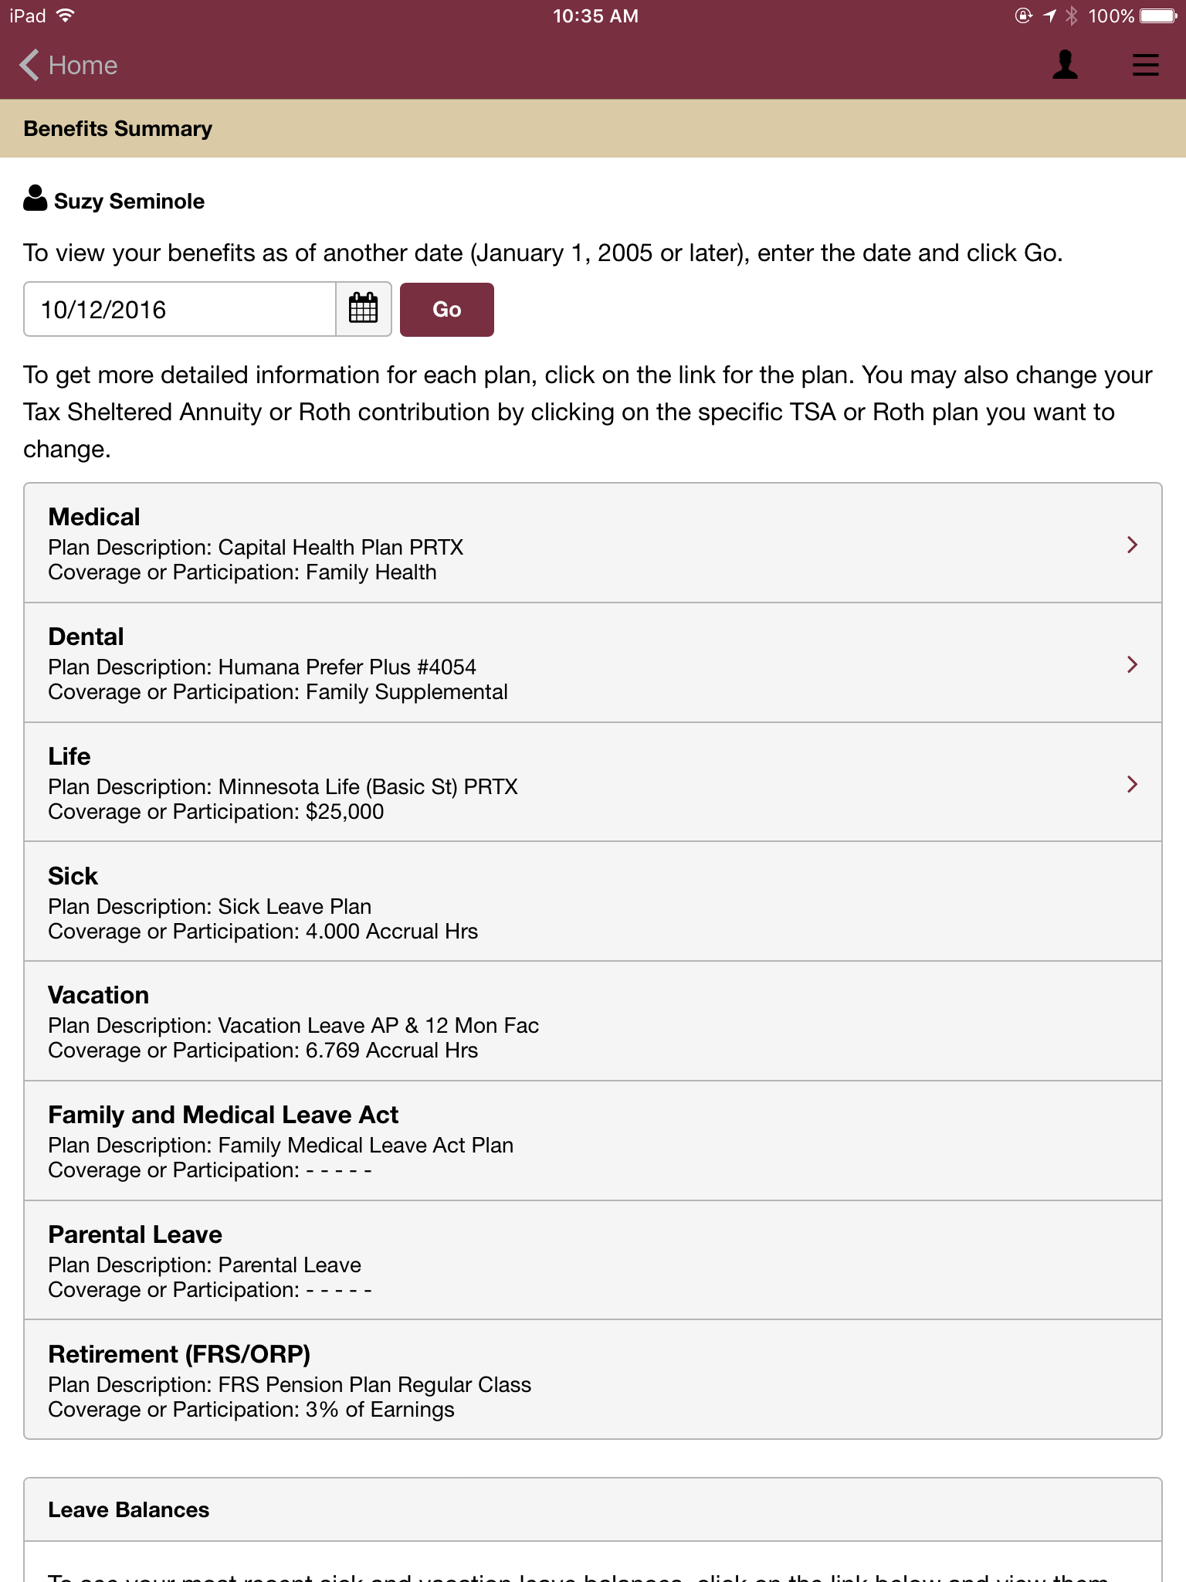
Benefits Summary Information

Slide 128
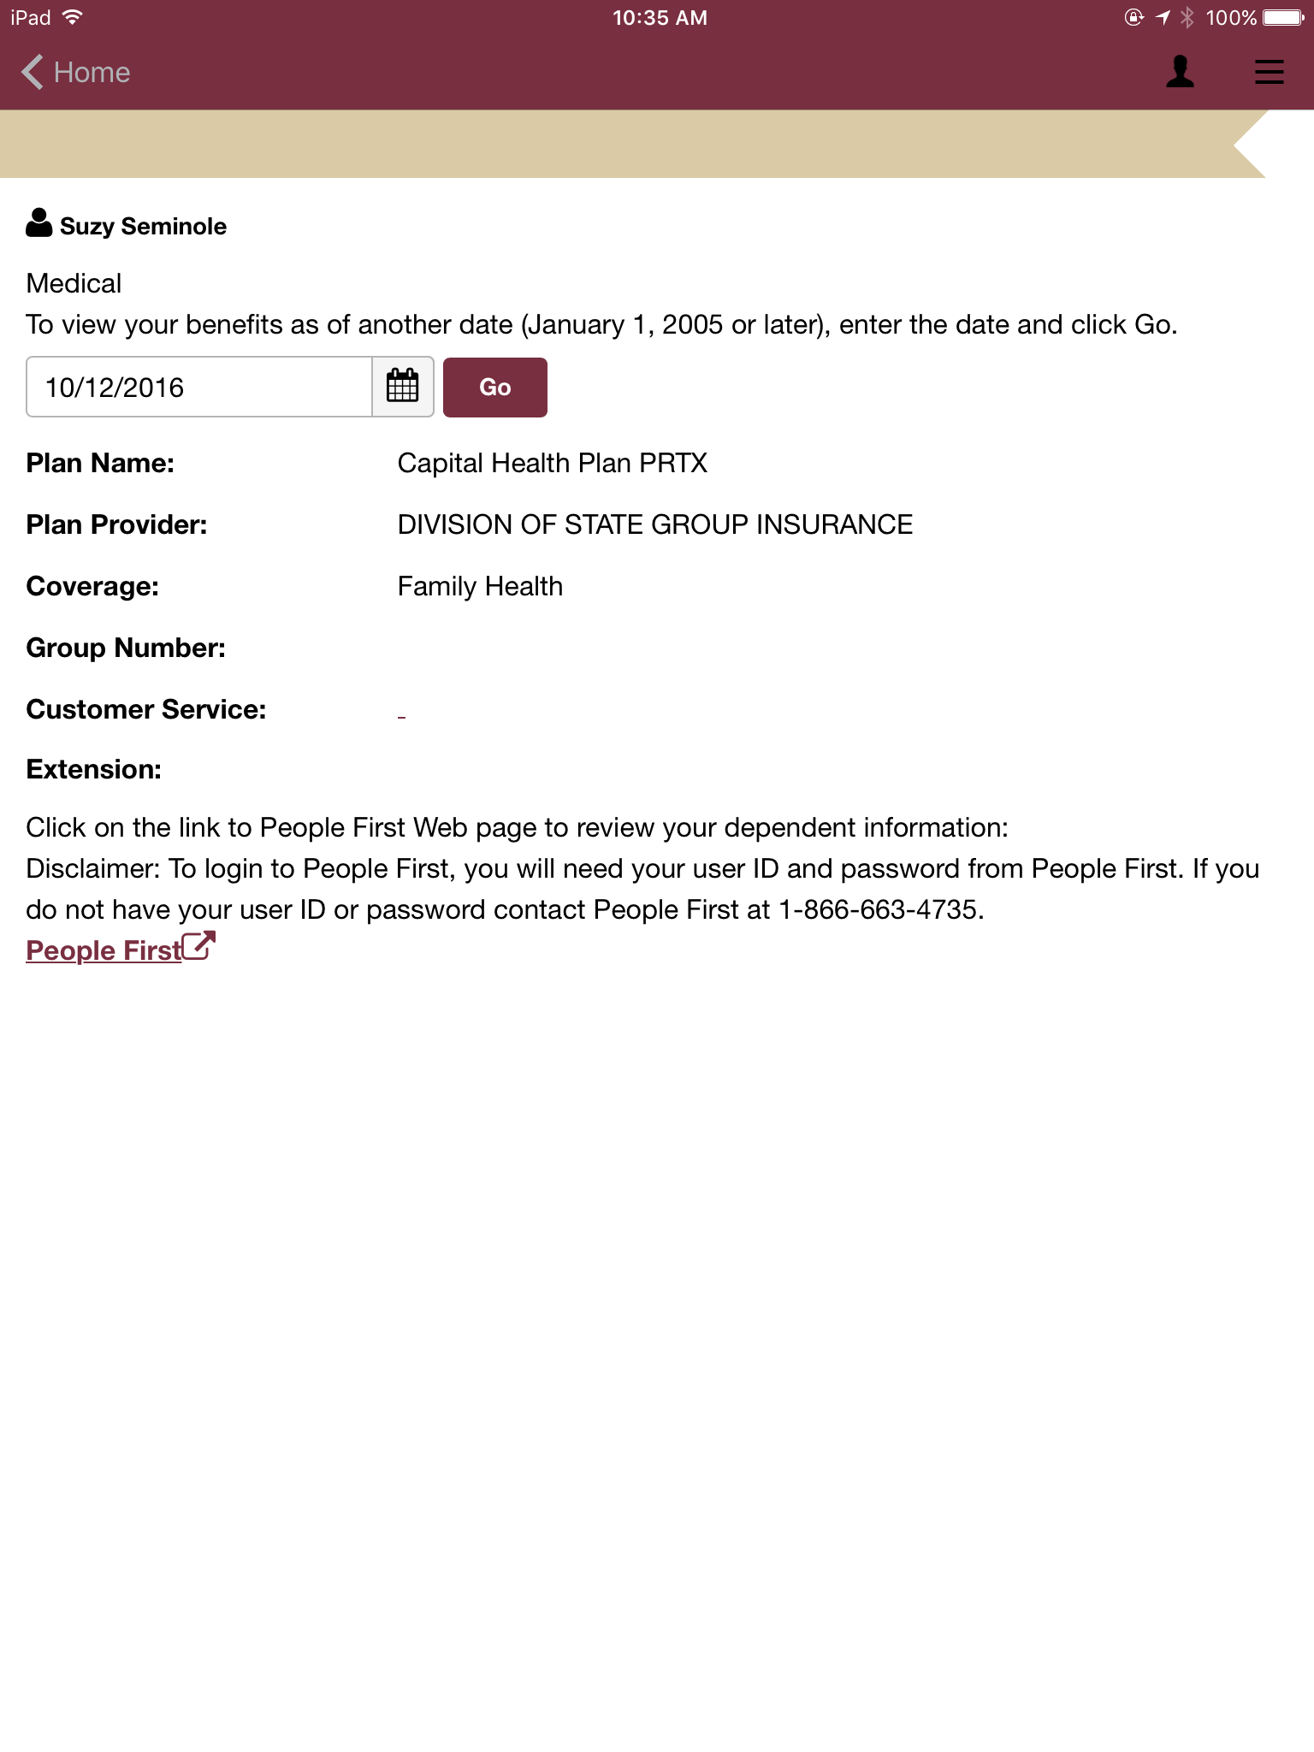
View
additional information about individual benefits

Slide 129
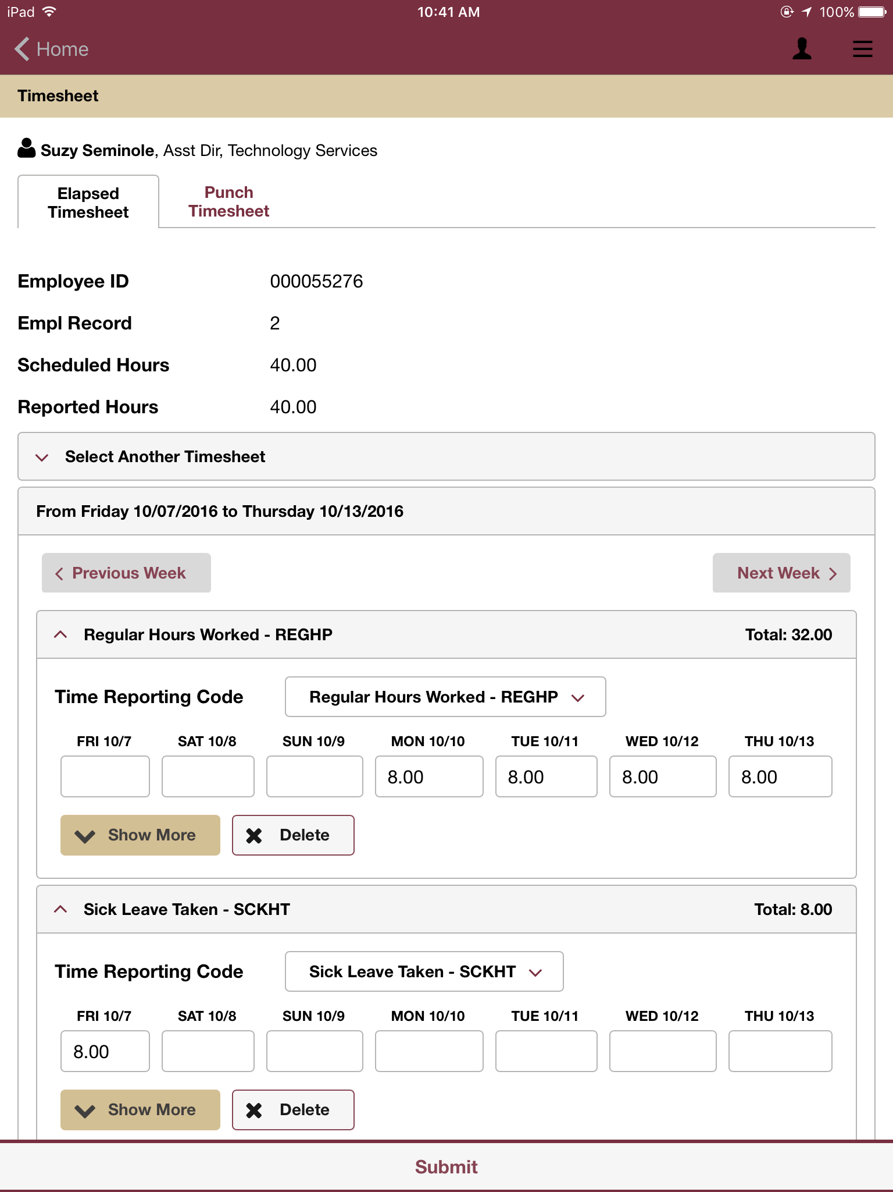
Enter time

Slide 130
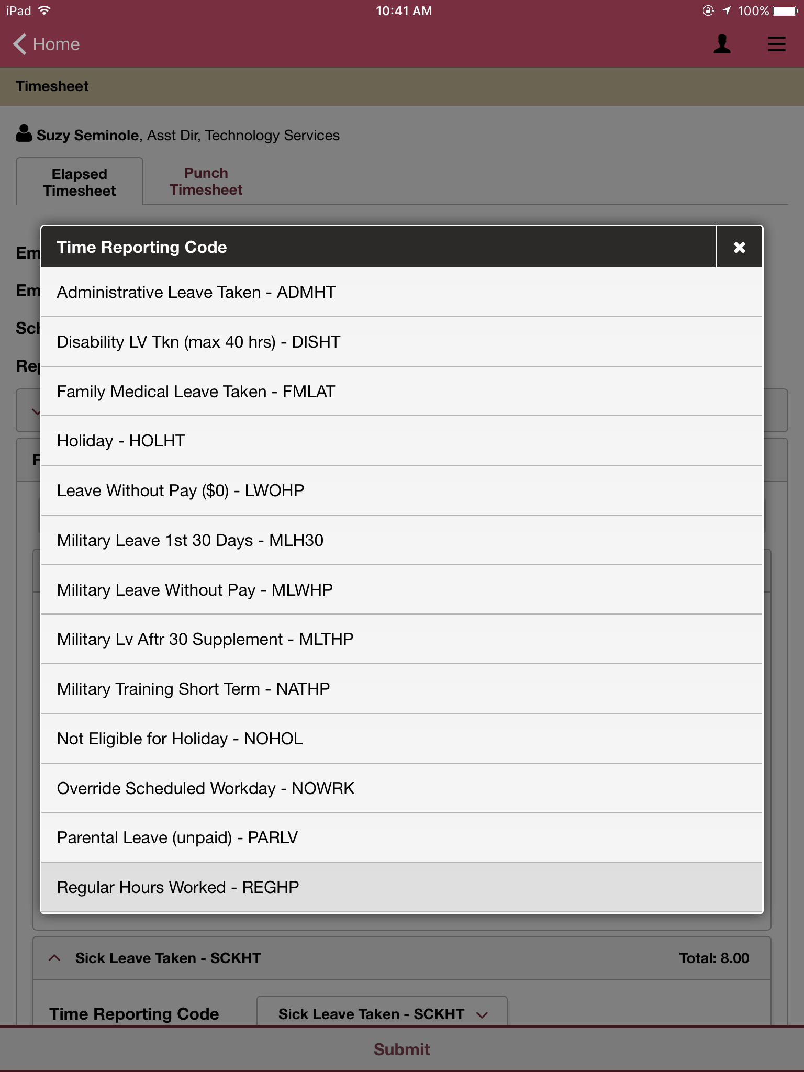
Same time reporting codes available

Slide 131
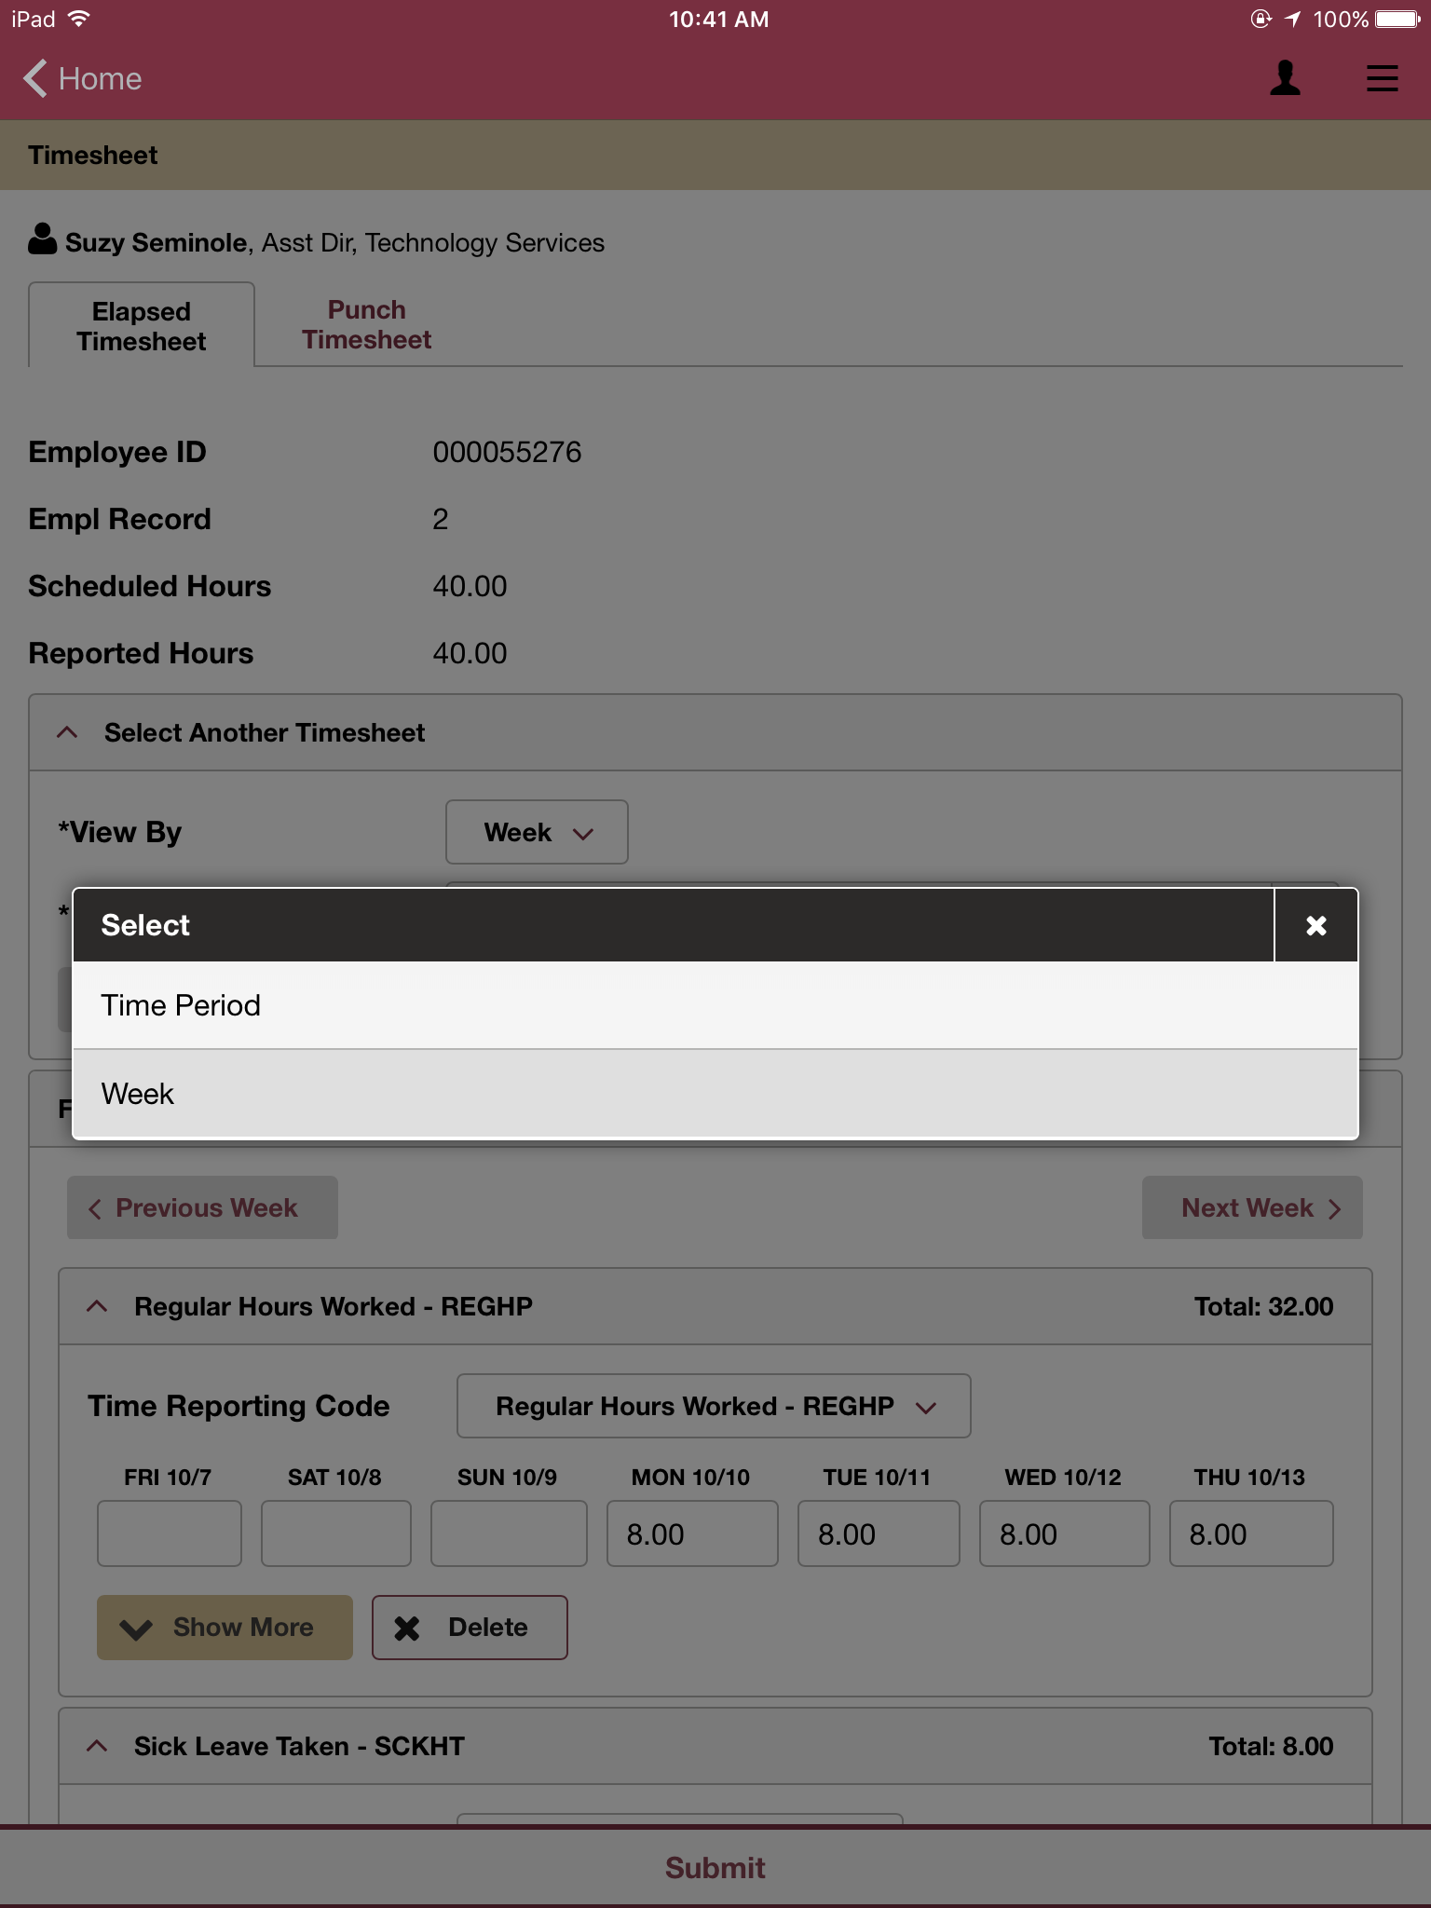
Time period or work week

Slide 132
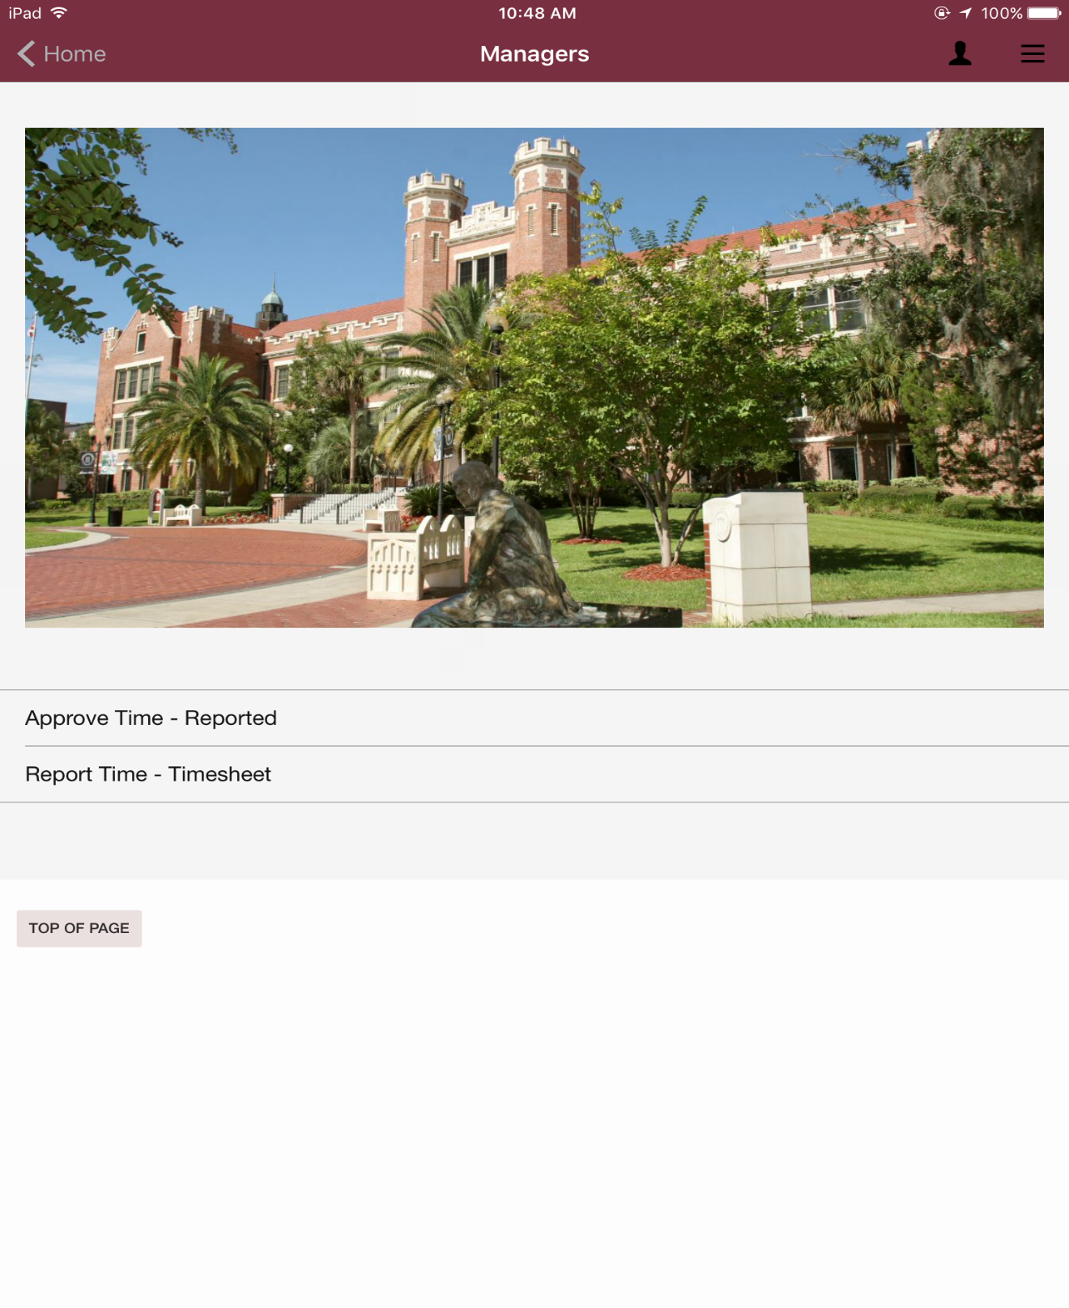
Managers can approve time or
report time
for employees.

Slide 133
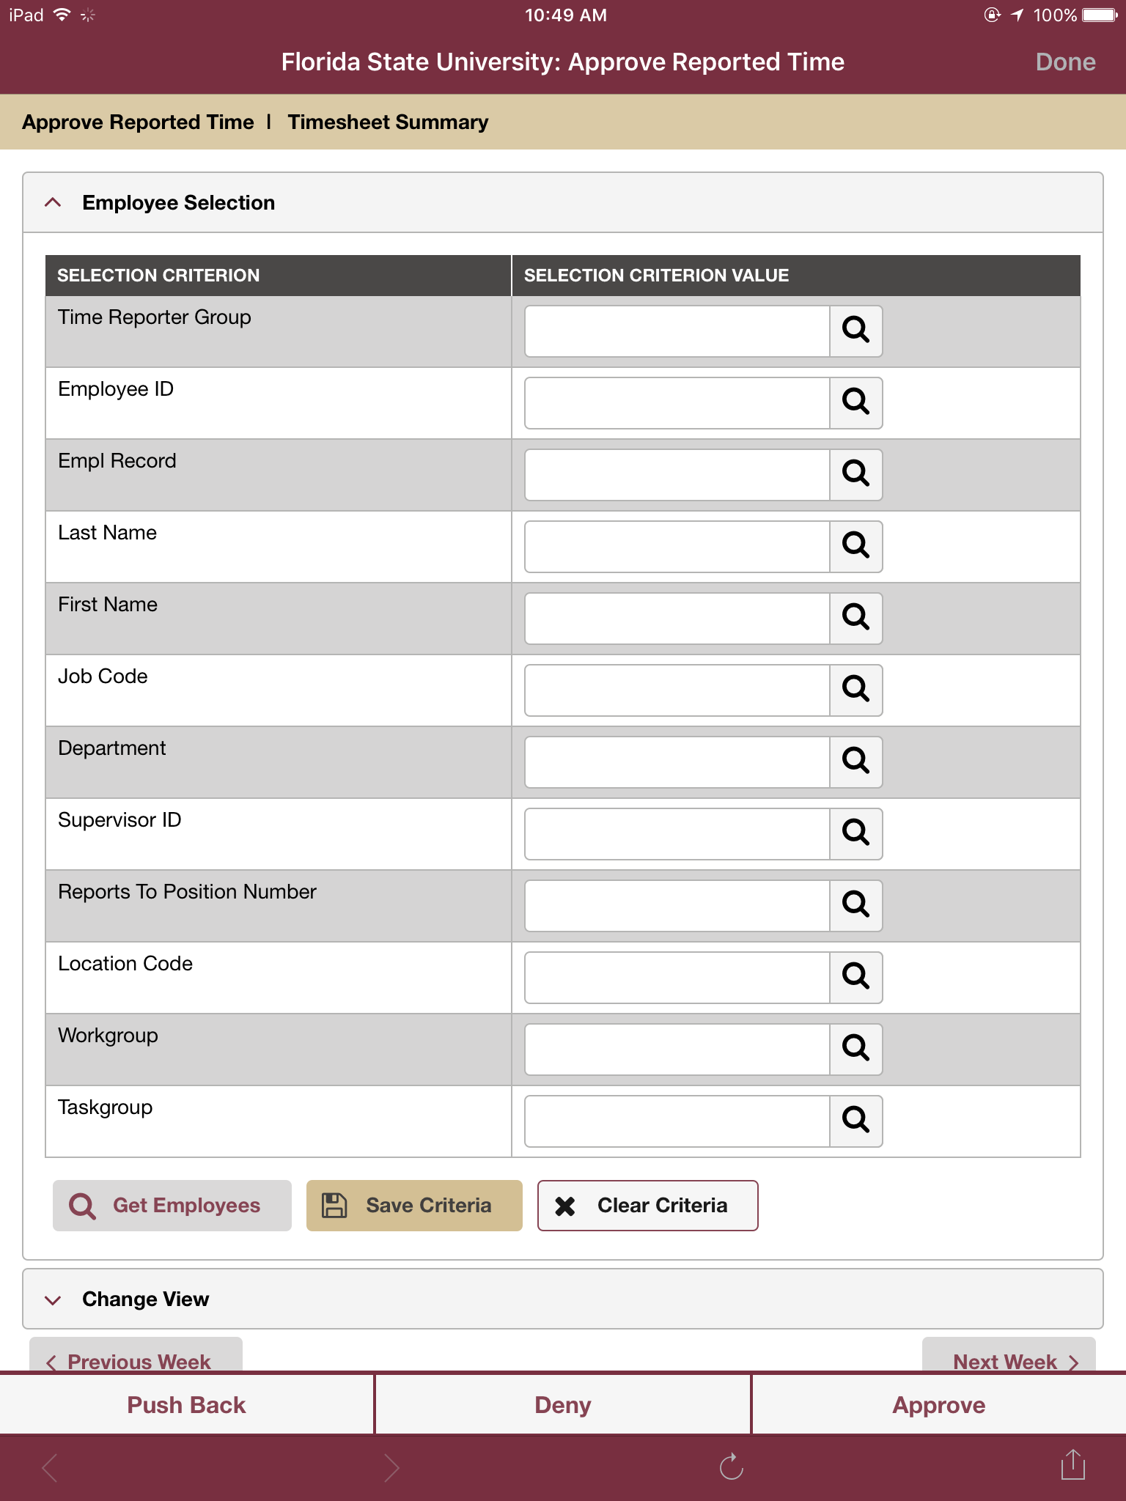
Approve by Group ID
Same search option criteria as OMNI HR

Slide 134
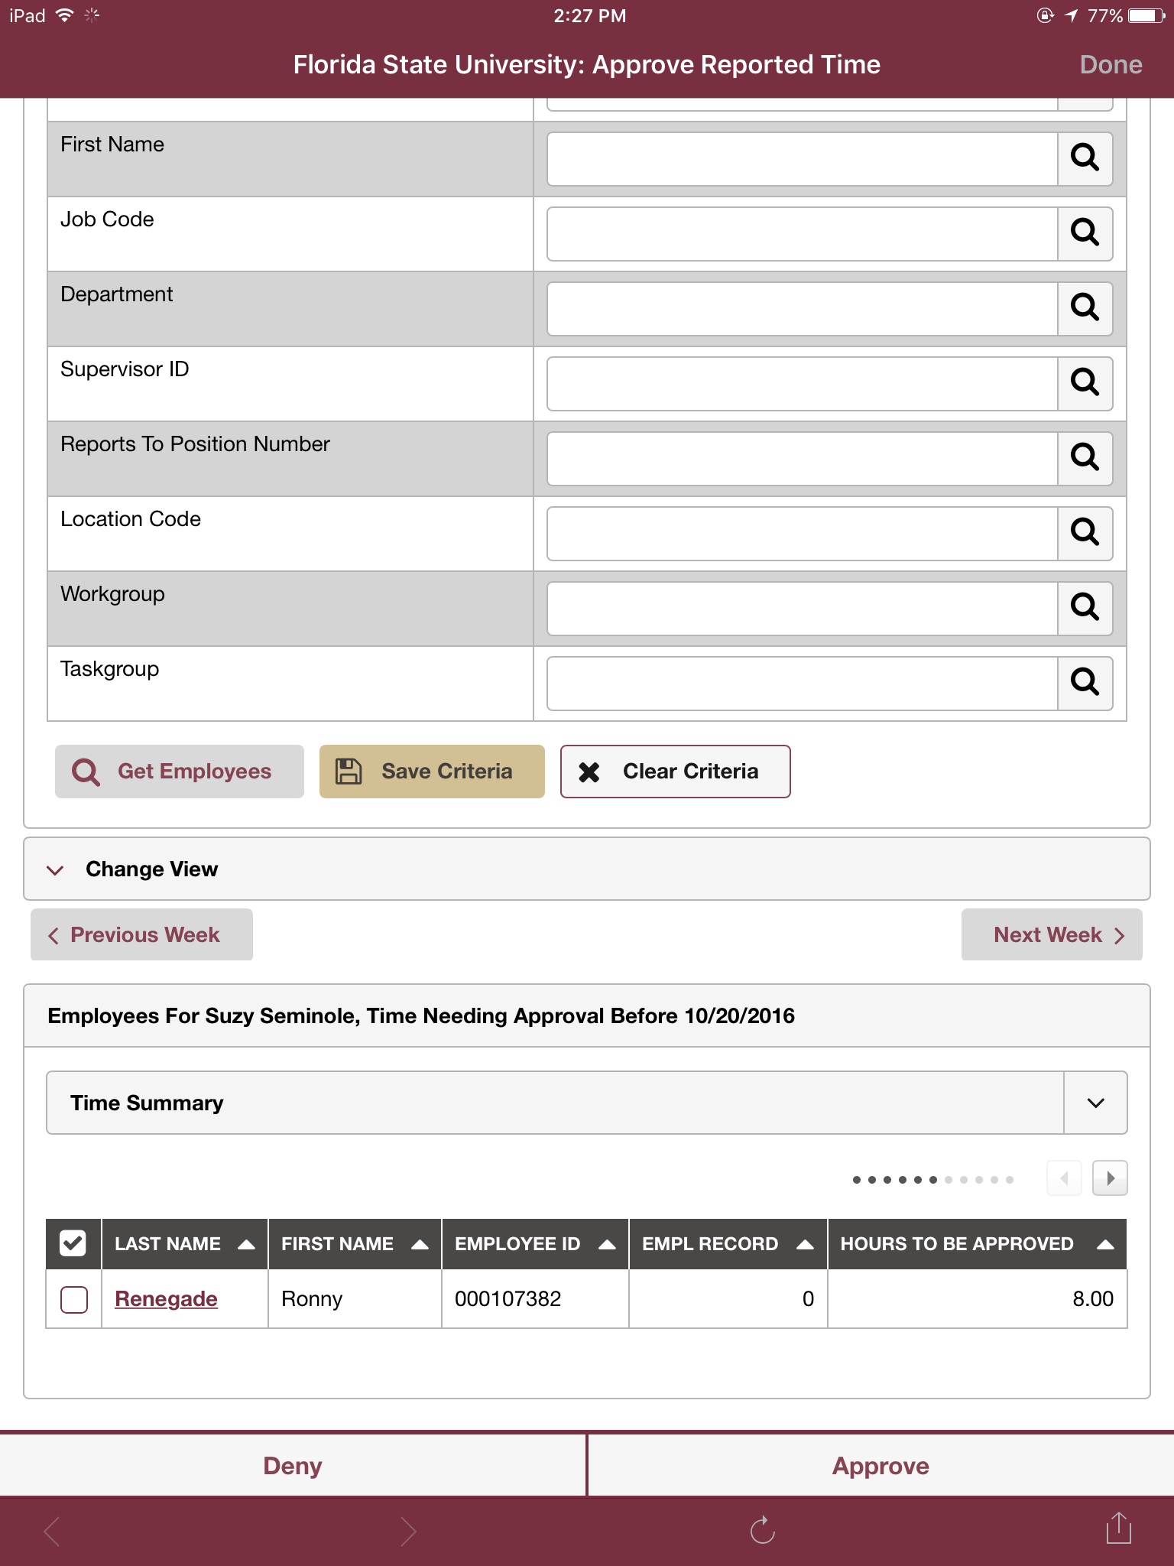
Approve individual employee timesheet

Slide 135
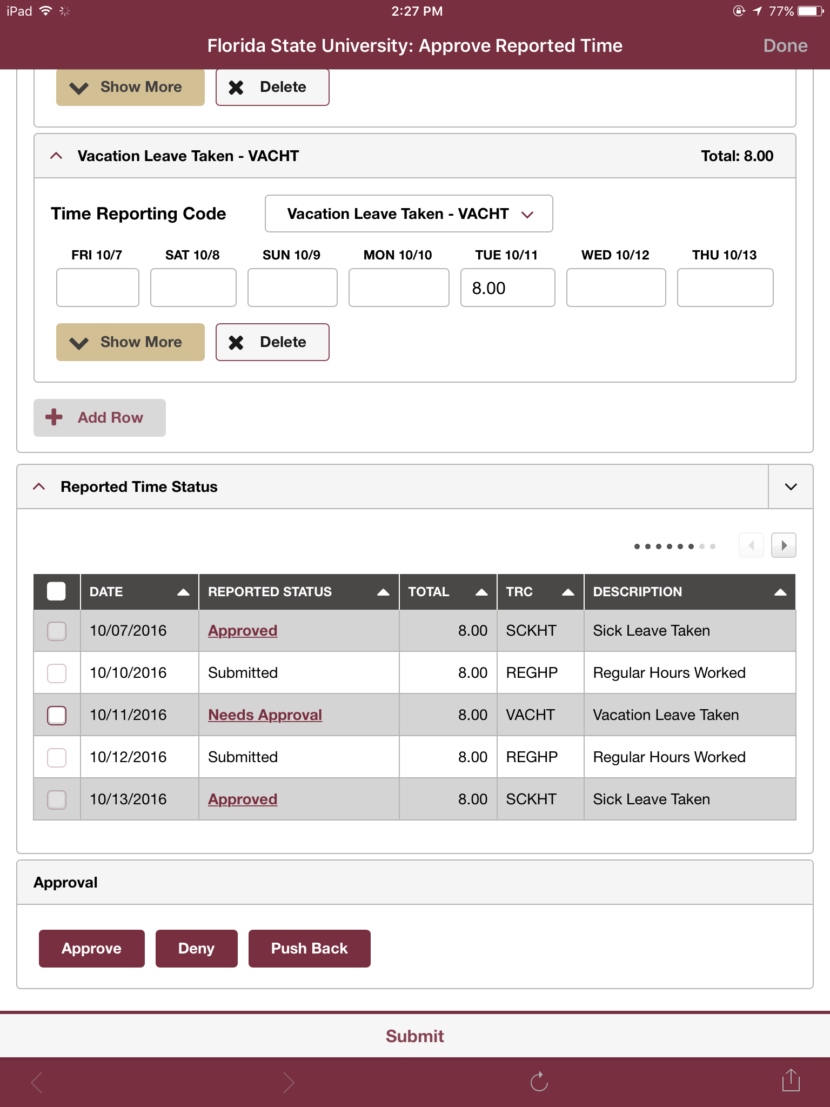
View individual time

Slide 136
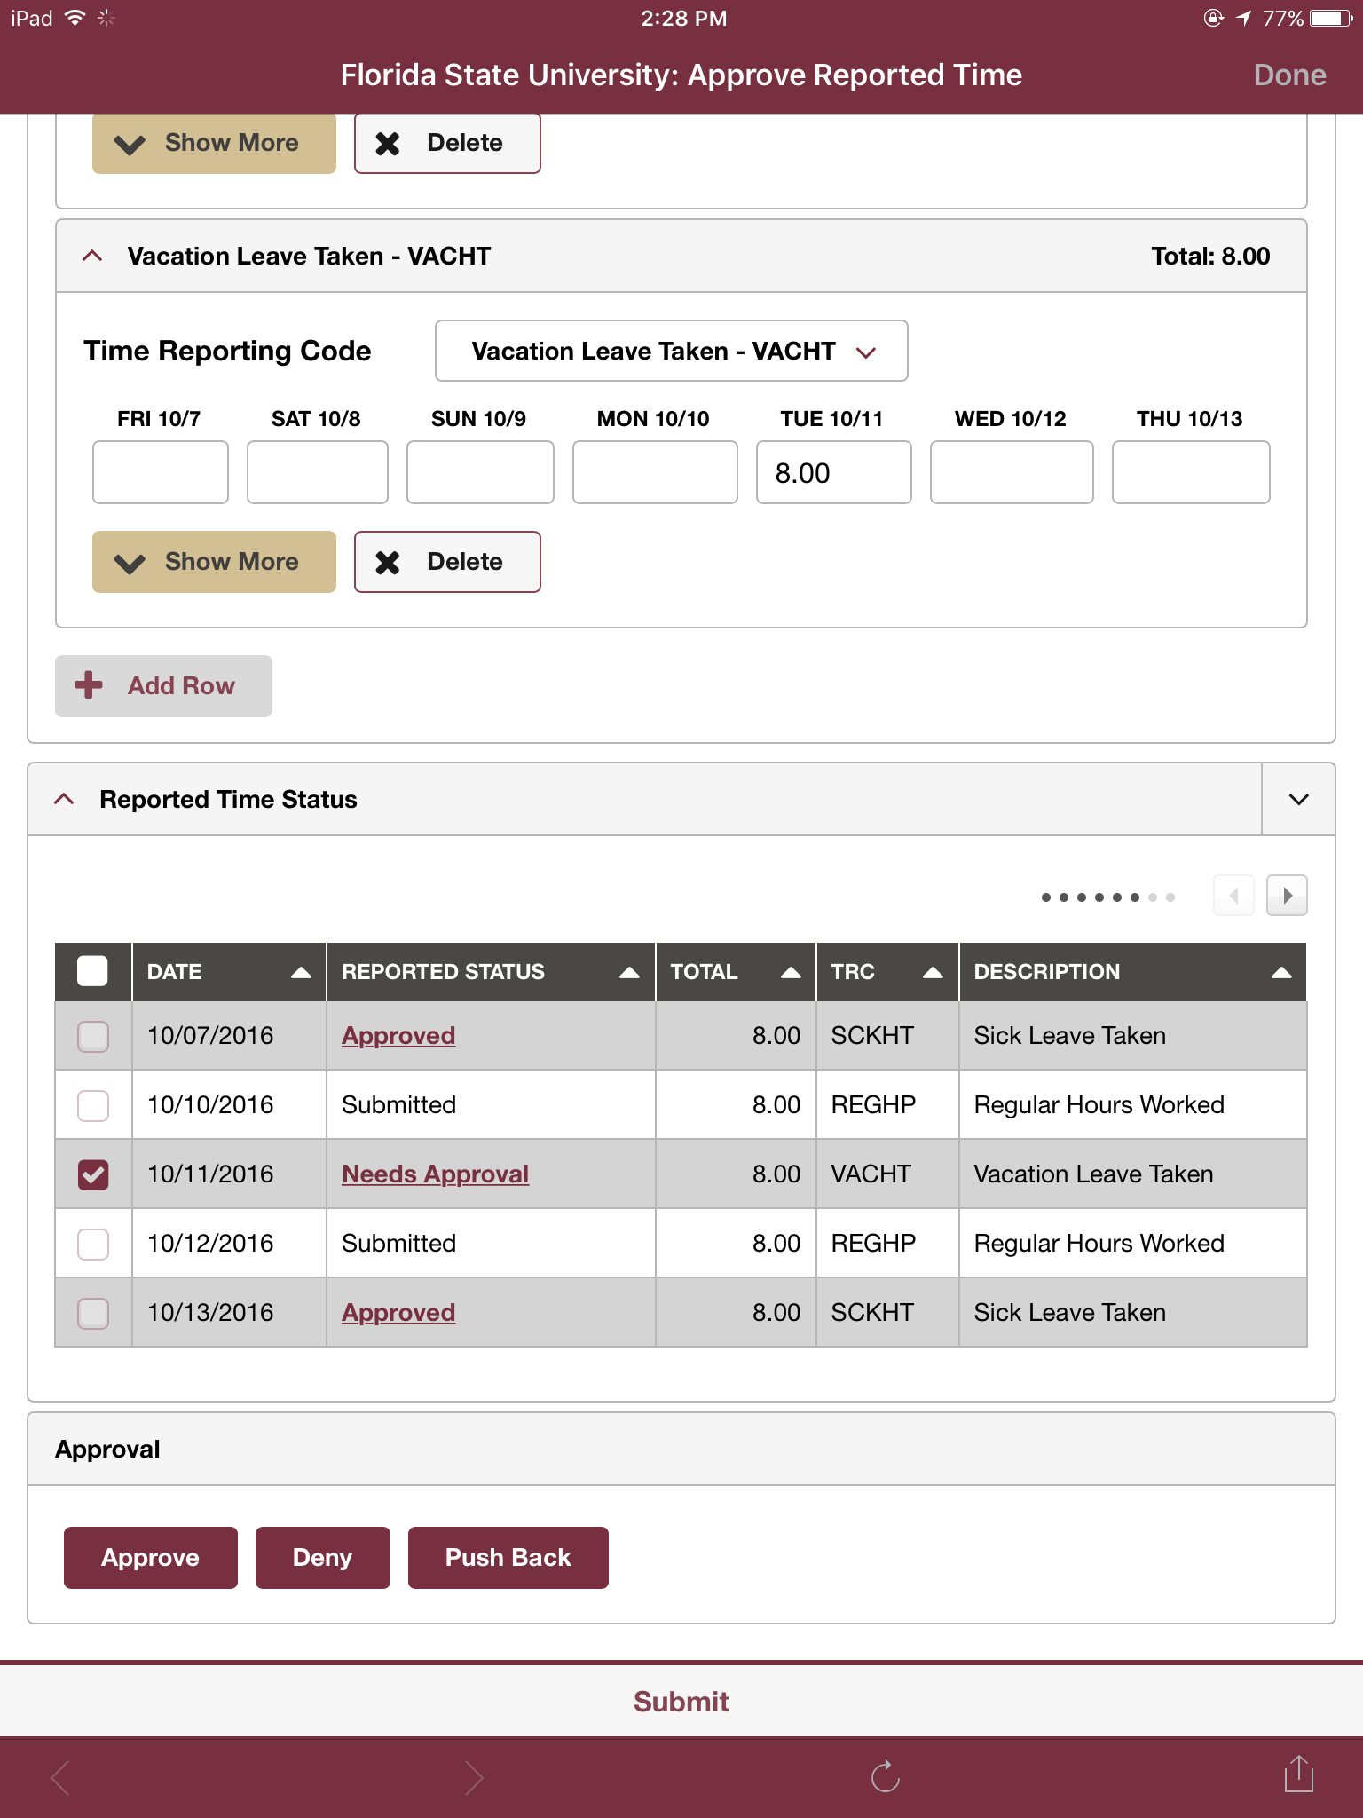
Check box to approve time

Slide 137
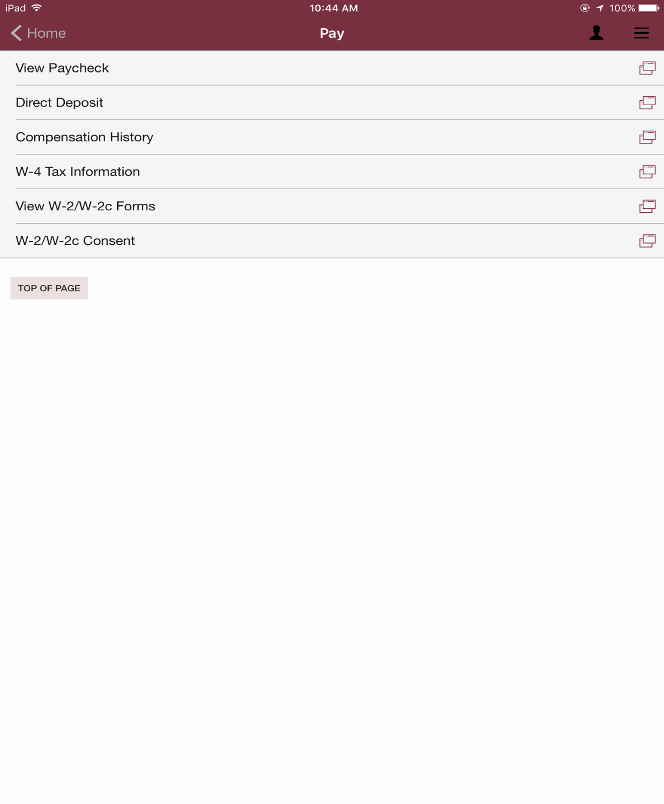
View available Pay information

Slide 138
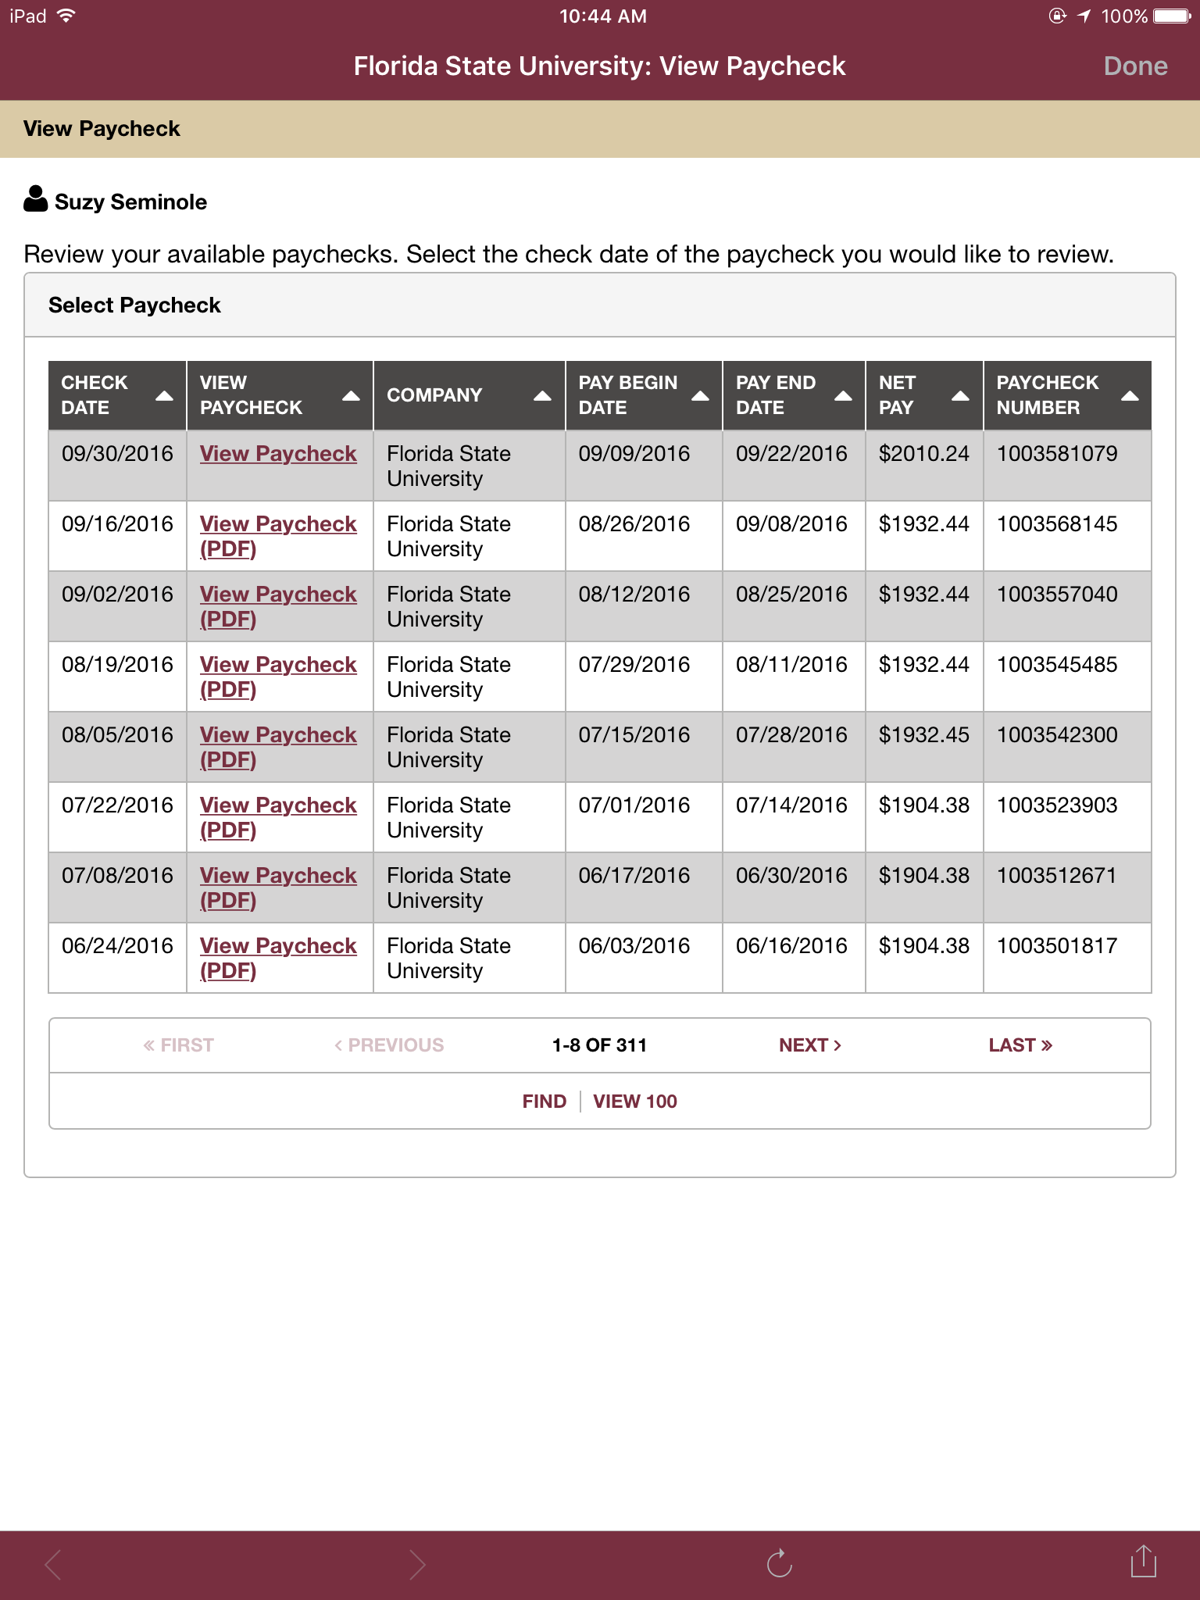
View Paycheck Information

Slide 139
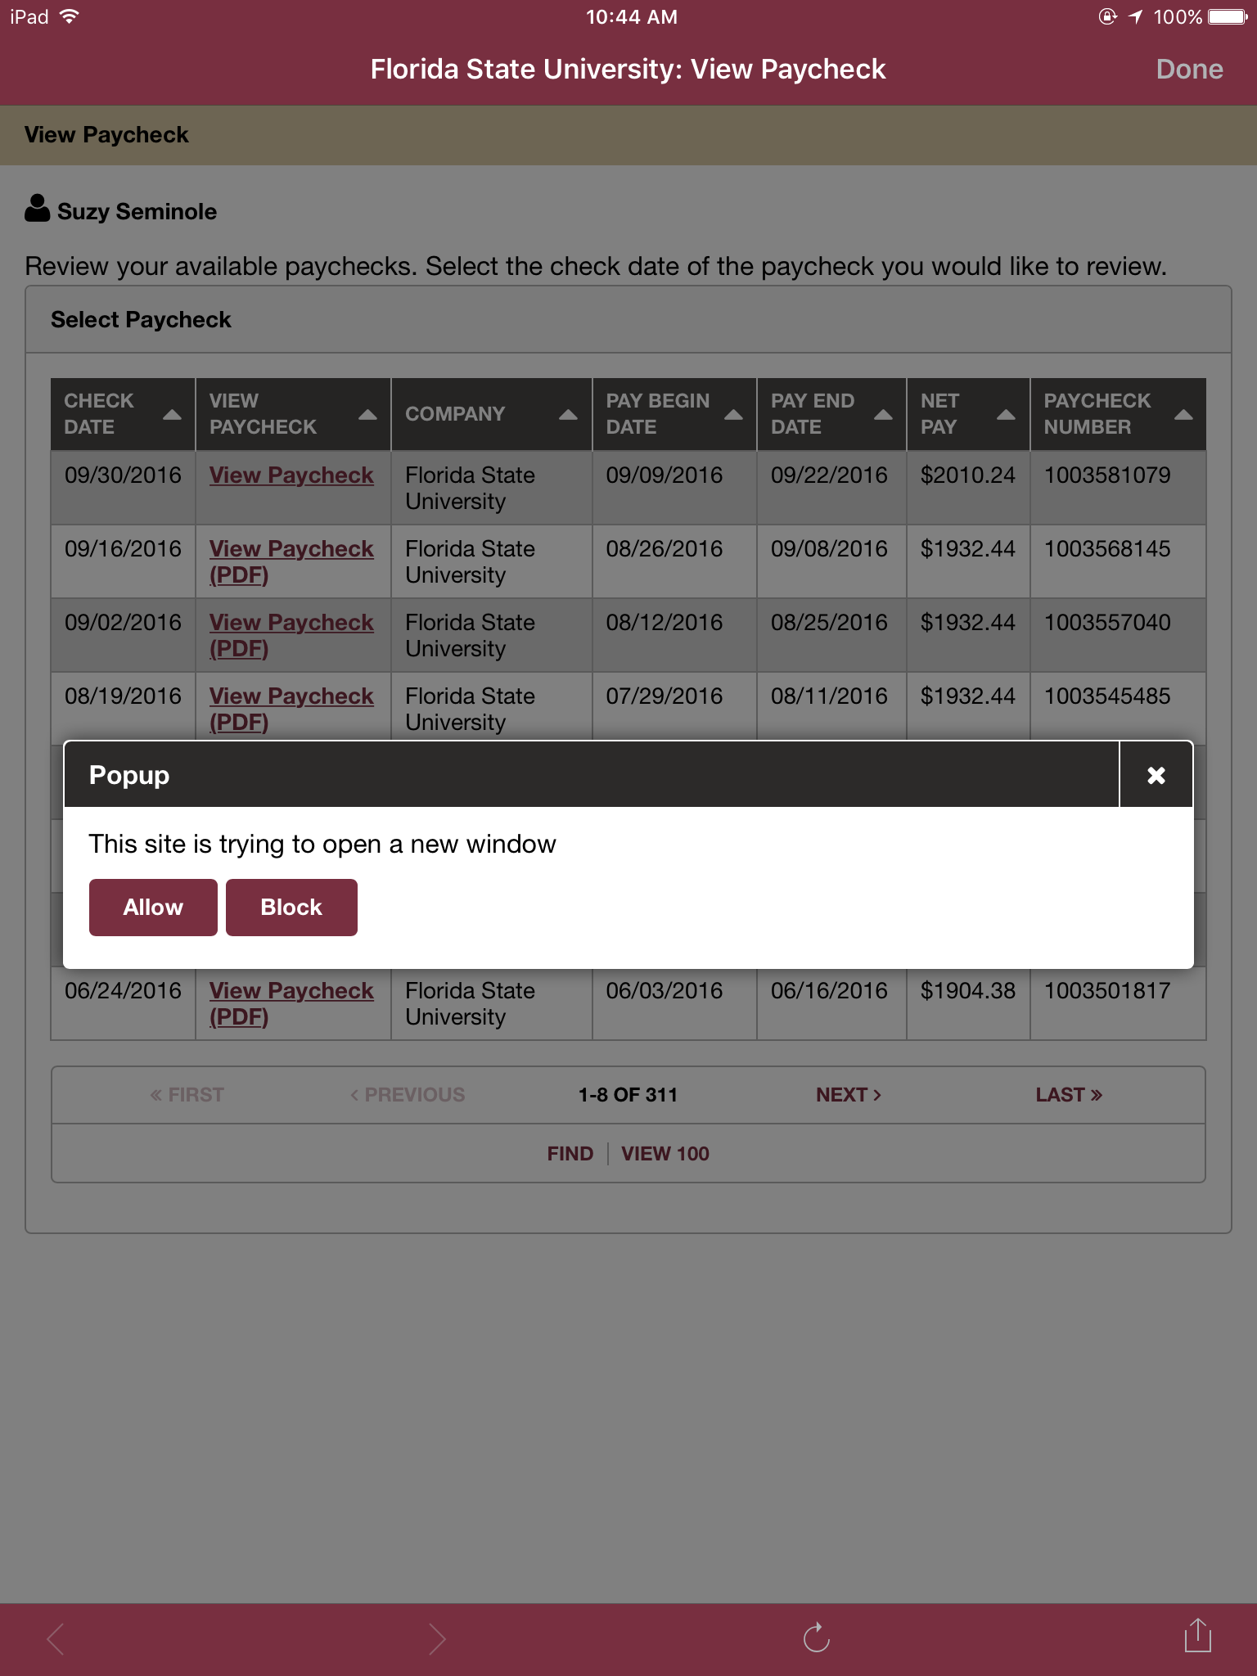
Open new window

Slide 140
Direct deposit detail

Slide 141
Smart Onboarding Update
Phaedra Harris
Director, HR Operations

Slide 142
What is Smart Onboarding?
HR Customer Service Initiative
Holistic Improvement of New Employee Onboarding

Slide 143
Goals
Reduce
Time to hire
Data entry
Forms/Paper
Consolidate
Data
Process steps
Improve
Communication/visibility (with departments and candidates)
Ease of use
First impression of FSU

Slide 144
Scope
Top Candidate Selected
Candidate Vetting
Forms
Hire
New Employee Orientation
Salary
Background Check
Nepotism
Outside Employment
Dual Comp
Load to OMNI HR
Disposition Codes
Job Offer
Salary Explanation
Direct Deposit
EEO Data
I-9
Policies
W-4
Etc.

Slide 145
Key Features
New comprehensive onboarding portal
Background check better integrated into position
Better sequencing of steps (simultaneous processing)
Department dashboards to view status
Electronic flow of department steps & approvals
Fewer points of VP/high-level approval required
Eliminates paper

Slide 146
Portal Look

Slide 147
Project Status
Team Assembled
Software Contract
Enhancing current eRecruit processes
Developing portal with software vendor (Smart ERP)
Finalizing workflows/approvals
Pilot Group
Campus Rollout

Slide 148
The Team
+
+
+

Slide 149
Timeframe
Fall 2016 – Portal Development
Early Spring 2017 – Testing/Training
Spring Semester 2017 – Pilot Group
Summer/Fall 2017 – Campus-wide Rollout

Slide 150
Door Prize

Slide 151
Questions & Answers

Slide 152
Closing Remarks
Sarah Mirkin,
HR Communications Manager

Slide 153
Thank You!

