Slide 1
FLORIDA STATE UNIVERSITY
Office of Human Resources
Human Resources
Department Representative Meeting
October 16, 2013

Slide 2
FLORIDA STATE UNIVERSITY
Office of Human Resources
Welcome / Introduction
Renisha Gibbs
Interim Assistant Vice President,
Chief Human Resources & Diversity Officer
Kyle Clark
Vice President for Finance and Administration

Slide 3
FLORIDA STATE UNIVERSITY
Office of Human Resources
New HR Employees
Bill Strickland, Senior HR Specialist
Vickie Robinson, Senior HR Specialist
Denice Henderson, HR Specialist
Kendrick Scott, HR Specialist
Ellen King, HR Specialist
Rita Albert, HR Representative
Dallas Beckett, HR Representative
Tamieka McFadden, HR Representative
Victoria Powell, HR Representative
Jomar Fraser, HR Representative
Rachel Slingsby, Classification Analyst
Waukesha Peterson, Classification Analyst
Mayank Sharma, Application Developer/Designer
Darren Rajendranath, IT Support Specialist

Slide 4
Specialized Faculty Reclassification Process
FLORIDA STATE UNIVERSITY
Office of Human Resources
Susannah C. Miller
Director, Human Resources
Faculty Relations, Diversity & Inclusion, & Employee Ombuds Program

Slide 5
FLORIDA STATE UNIVERSITY
Office of Human Resources
Information Sessions Posted on Training Website
Online Training Available via the HR Website
Project Document Available via the HR Website

Slide 6
FLORIDA STATE UNIVERSITY
Office of Human Resources
Now – December Information Sessions, Placement
Discussions Take Place
November Placement Process Published,
Forms Distributed
Nov – December Submit Reclassification Actions to HR
December 20 12-month NTTF Reclassification
            Actions Take Effect
December 23 9-month NTTF Reclassification
Actions Take Effect
Spring 2014 Specialized Faculty Promotion Process

Slide 7
FLORIDA STATE UNIVERSITY
Office of Human Resources
Contacts
Susannah Miller
645-1708 or scmiller@fsu.edu
Bill Strickland
645-2202 or bstrickland2@fsu.edu

Slide 8
Faculty Pay Increases
Administrative Discretionary Increases
FLORIDA STATE UNIVERSITY
Office of Human Resources
Bill Strickland
Sr. Specialist, Human Resources

Slide 9
FLORIDA STATE UNIVERSITY
Office of Human Resources
Administrative Discretionary Increases
Counter-offers
Endowed/named-chairs at the time they are awarded
Extraordinary accomplishments
Equity adjustments
Increased duties and responsibilities
Recognition for distinguished faculty

Slide 10
FLORIDA STATE UNIVERSITY
Office of Human Resources
Administrative Discretionary Increases
Must be accompanied by specified documentation to justify the increase, pursuant to the collective bargaining agreement

Slide 11
FLORIDA STATE UNIVERSITY
Office of Human Resources
Counter-Offers
Must be accompanied by a copy of the verified written offer

Slide 12
FLORIDA STATE UNIVERSITY
Office of Human Resources
Endowed/Named Chairs
Must be accompanied by a copy of the criteria and procedures for the award of the chair

Slide 13
FLORIDA STATE UNIVERSITY
Office of Human Resources
Extraordinary Accomplishments
Must be accompanied by an explanation of how the accomplishments exceed the minimum criteria for the top merit category of the department/unit, or
When based on an external award or similar, must be accompanied by the specific external award or alternative criteria which is considered “prestigious” or “highly prestigious”

Slide 14
FLORIDA STATE UNIVERSITY
Office of Human Resources
Equity Adjustments
  Must be accompanied by the salaries and history of annual accomplishments of the group(s) relative to which the inequity is to be corrected
  Must be based on criteria and procedures published by the dean of each college/unit and provided to the UFF Chapter at least 45 days before implementation

Slide 15
FLORIDA STATE UNIVERSITY
Office of Human Resources
Increased Duties & Responsibilities
  Must be accompanied by the signed annual Assignments of Responsibility (AOR) for the year preceding the change and the new one reflecting the increased duties and responsibilities

Slide 16
FLORIDA STATE UNIVERSITY
Office of Human Resources
Recognition of Distinguished Faculty
  Must be accompanied by the specific external award ,
  or
  Must be accompanied by alternative criteria which justifies the designation of “Distinguished” or “with Distinction”

Slide 17
FLORIDA STATE UNIVERSITY
Office of Human Resources
ADI Processing
Memo from Department
OFDA for Approval
Provost for Approval
OFDA
EDM
Faculty Relations for Approval
EDM for Processing
UFF for Acceptance (after expiration of CBA and pending a new CBA)
UFF as Notice (if not required to send for acceptance, as mentioned above)

Slide 18
FLORIDA STATE UNIVERSITY
Office of Human Resources
Contact
Bill Strickland
645-2202 or bstrickland2@fsu.edu

Slide 19
I-94 Changes/Updates
FLORIDA STATE UNIVERSITY
Office of Human Resources
Kristen Hagen
Associate Director, Academic & Student Services
Center for Global Engagement

Slide 20
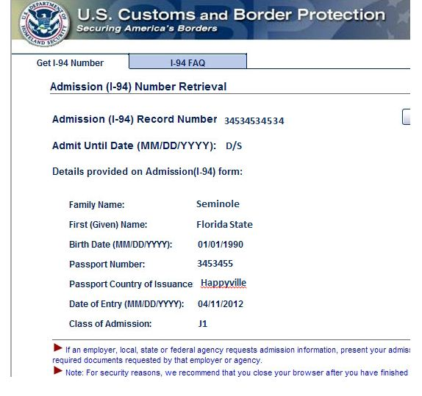
FLORIDA STATE UNIVERSITY
Office of Human Resources
I-94 is Now Electronic!!
Paper I-94 cards are only used at land borders (cruises, crossing by foot or car)
All other I-94 records must be printed from www.cbp.gov/i94
Visiting scholars do not immediately have an FSUID or access to a printer, so you might need to help them print the I-94 for the SSN application
Students can use library or computer lab printers

Slide 21

FLORIDA STATE UNIVERSITY
Office of Human Resources
Electronic I-94 and SSA
The electronic I-94 allows entry information to be viewed more quickly by SSA, in most cases.
Students and scholars must check-in with the CGE at least 3 days before they go to SSA, because our validation/registration of the record takes some time to upload to SSA.
SSA still instructs everyone to wait 10 days, but they will not generally turn away a student or scholar who applies a little earlier.
No applications for new or replacement cards accepted during government shutdown.

Slide 22
FLORIDA STATE UNIVERSITY
Office of Human Resources
Housing Issues
Alumni Village will close on August 22, 2014!
There is no alternate on-campus housing for visiting scholars.
Incoming visiting scholars/post-docs and those in AV will need to search for off-campus housing options.
Graduate students accepted for Fall after May 1 will need to look for off-campus options.
Short-term off-campus contracts are very limited; we recommend that scholars who will be at FSU for 12 months do NOT spend the first few months in AV and then look off-campus.

Slide 23
FLORIDA STATE UNIVERSITY
Office of Human Resources
Cost of Living for Students & Scholars
Each year, living expenses are re-evaluated and usually increase; therefore we require that all combined funding sources meet the new estimated cost of attendance prior to issuing an I-20.
Scholar funding amounts are now based upon 185% of the poverty rate, but paid scholars should always receive the same rate of pay as anyone else in the same position.

Slide 24
FLORIDA STATE UNIVERSITY
Office of Human Resources
Our New Website!
www.cge.fsu.edu
Department information is under International Students & Scholars – Information for Departments.
Global Partners Certificate information is under Training and Academic Courses – Global Partner Certificate.
Be sure to join our Department Listserv for weekly updates. (Link to join is under General Information: http://cge.fsu.edu/infofordept/deptmailinglist.cfm)

Slide 25
Graduate Assistant Appointments,
Waivers, and Reporting
FLORIDA STATE UNIVERSITY
Office of Human Resources
Brian Barton
Coordinator, The Graduate School

Slide 26
Employment/Recruitment &
Compensation/Classification Reminders
FLORIDA STATE UNIVERSITY
Office of Human Resources
Drew Meehan
Associate Director, Human Resources

Slide 27
FLORIDA STATE UNIVERSITY
Office of Human Resources
Updated Position Description/Background Checks
Veterans Preference/In-Unit Candidates
Regret Letters
Online Job Boards
Work Product Testing
Internet Browsers
Online New Employee Wizard Process
Creating New Positions
Restructures

Slide 28
BREAK
FLORIDA STATE UNIVERSITY
Office of Human Resources

Slide 29
Benefits/Retirement
FLORIDA STATE UNIVERSITY
Office of Human Resources
Linda Lieblong
Associate Director, Human Resources

Slide 30
FLORIDA STATE UNIVERSITY
Office of Human Resources
Bencor
Domestic Partner Benefits
Affordable Care Act (ACA)
New Employee Orientation
Open Enrollment

Slide 31
I-9s
FLORIDA STATE UNIVERSITY
Office of Human Resources
Andrew Kapec
HR Specialist, Employee Data Management

Slide 32
FLORIDA STATE UNIVERSITY
Office of Human Resources
Guardian
  System where I-9s are completed, stored, and maintained
  Similar to OMNI
LawLogix
  Company which operates Guardian
  Similar to Oracle over OMNI
E-Verify
  Federal system which compares information from I-9 Form to SSA and DHS Databases
    This is done through a case which must be closed
  Not associated with Guardian
  Does not verify the I-9 Form was completed correctly

Slide 33
FLORIDA STATE UNIVERSITY
Office of Human Resources
Form I-9
  Federal form required for all paid employees
    Excludes vendors, courtesy appts, volunteers, etc…
  Verifies employee’s identity and work authorization
  Errors can incur heavy fines
  Intentional forgery is a felony
  Can be completed after Job Offer is accepted
  Must be completed by first day of work for pay
  Must be completed in Guardian (unless Remote Hire)
    No paper I-9s. No printouts.
  Must be completed for appointment to be processed

Slide 34
FLORIDA STATE UNIVERSITY
Office of Human Resources
Section 1
  Completed by employee only
    Employee must physically type or write their information
  Must be signed by employee only
    Employee must physically enter the online PIN number and click “Electronically Sign.”

Slide 35
FLORIDA STATE UNIVERSITY
Office of Human Resources
Section 2
  Employee physically presents acceptable original documents to FSU Rep
    No copies or scans
    No invalid or expired documents
Non-U.S. Citizens
  Follow I-9 Website when completing I-9s
  Special Rules apply
  Appointment will not be processed with incorrect Form I-9

Slide 36
FLORIDA STATE UNIVERSITY
Office of Human Resources
I-9 Process in Guardian
  Search “1 Minute I-9” Screen for employee with SSN
  Create New I-9
  Employee completes and signs Section 1
  FSU Rep completes and signs Section 2 using original documents
  FSU Rep selects “Mark Completed” and “Mark Approved”
    Guardian creates E-Verify Case automatically upon approval
  FSU Rep interacts with and closes E-Verify Case
  Employee leaves (see exceptions on E-Verify Page on I-9 Website)
  Done

Slide 37
FLORIDA STATE UNIVERSITY
Office of Human Resources
I-9 Audit should be completed
  Ensures all active employees have I-9s
  Ensures all I-9s are complete and valid
Keep Dashboard clean
  No red dots (expired I-9s)
I-9 Website
  http://hr.fsu.edu/CONTENT/I9

Slide 38
HR Reminders/Top 10
FLORIDA STATE UNIVERSITY
Office of Human Resources
Michelle Gardner
HR Specialist, Time and Labor

Slide 39
Time & Labor’s
Top 10 Reminders
FLORIDA STATE UNIVERSITY
Office of Human Resources

Slide 40
FLORIDA STATE UNIVERSITY
Office of Human Resources
HELP DESK
(850) 644-6664

Slide 41
FLORIDA STATE UNIVERSITY
Office of Human Resources
Contacts for Time & Labor
Christine Conley
Assistant Director
850-644-1978
Dallas Beckett
Human Resources
Representative
850-644-9641
Michelle Gardner
Human Resources Specialist
850-644-9610
Abigail Lejeune
Human Resources Specialist
850-644-1449
Lisa Rosenthal
Human Resources Specialist
850-644-7936

Slide 42
FLORIDA STATE UNIVERSITY
Office of Human Resources
Employees’ CURRENT email address
&
IDENTIFY YOURSELF!! As the Department Representative

Slide 43
FLORIDA STATE UNIVERSITY
Office of Human Resources
Navigation to a Paycheck
Main Menu >
Payroll for North America >
Payroll Processing USA >
      Produce Payroll >
Review Paycheck Summary

Slide 44
FLORIDA STATE UNIVERSITY
Office of Human Resources
Separation Checklist
DON’T Sign off on the Separation Checklist if you are not DONE with ALL the items on the Checklist.
Termination Effective Date
The termination effective date is ALWAYS the day AFTER the last day worked.

Slide 45

FLORIDA STATE UNIVERSITY
Office of Human Resources
Termination
It is not a Termination unless you LEAVE FSU!!
If you are going to another department, it is a…

Slide 46

FLORIDA STATE UNIVERSITY
Office of Human Resources
Holiday Reporting
To report a Holiday or not to report a Holiday, that is the question??

Slide 47
FLORIDA STATE UNIVERSITY
Office of Human Resources
Overtime
ALL Overtime must be JUSTIFIED and APPROVED prior to actually working it.

Slide 48
FLORIDA STATE UNIVERSITY
Office of Human Resources
Timesheet
ONLY LOOK AT THE TIMESHEET BY THE WEEK VIEW (NOT THE TIME PERIOD VIEW)!

Slide 49

FLORIDA STATE UNIVERSITY
Office of Human Resources
When you are sent an email please read it in its entirety, you may find the answer in the email!

Slide 50

Tobacco-Free Campus Update
Increasing Campus Health, Success, and Lifelong Productivity
FLORIDA STATE UNIVERSITY
Office of Human Resources
Shiffany Rawls
Assistant Director, Facilities Human Resources
University Tobacco Free Implementation Committee
Kevin T. Frentz, Ph.D., Health Promotion and Policy Coordinator,
University Health Services, Director, MPH Community-Based Public Health Research
Lynn M. Vinson, B.S., CTTS, Tobacco Treatment Specialist

Slide 51
Presentation Goals
FLORIDA STATE UNIVERSITY
Office of Human Resources
To address questions you might have about issues related to the Tobacco-Free FSU Initiative, such as:
    Why a Tobacco-Free Campus
    How is Compliance/Enforcement to be Addressed
    Implementation & Awareness Efforts
    Availability of Cessation Services

Slide 52
Why Become Tobacco-Free?
FLORIDA STATE UNIVERSITY
Office of Human Resources
Smoking is the leading cause of preventable death in the United States
Secondhand smoke is the third leading cause of preventable death in the United States
There is no safe level of contact with secondhand smoke; even brief exposure is harmful
Smokeless tobacco (spit tobacco) is a major cause of oral cancer and other health issues
Hookah smoking has been associated with lung cancer, oral cancer, heart disease, and respiratory illness

Slide 53
Why Become Tobacco-Free?
FLORIDA STATE UNIVERSITY
Office of Human Resources
In 2006, FSU adopted Breathe Easy Zones
While this was a step forward, students and staff are still affected by smoking on campus
Smoking bans are more effective than smoking restrictions and are one of the most effective evidence-based methods to help both:
  Protect people from exposure to secondhand smoke*
  Help people quit tobacco use*
* Am J Prev Med 2001; 20(2S): 16-66.

Slide 54
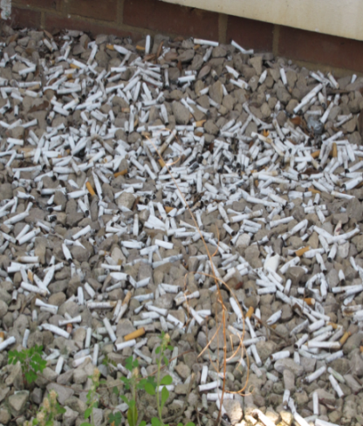
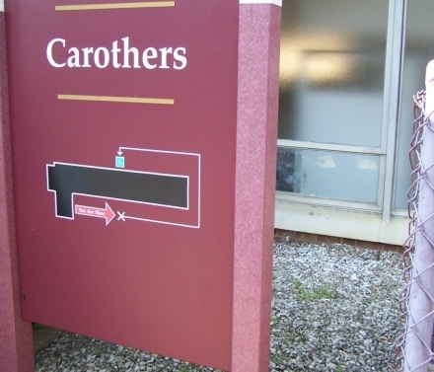
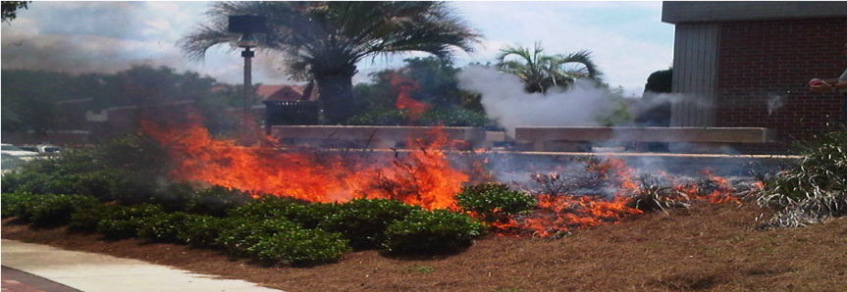
Cost and Liability
FLORIDA STATE UNIVERSITY
Office of Human Resources
Cost-saving on facilities and maintenance
Sustainability
Reduce risk of fires
Legal liability
Smoking is the leading cause of fire-related deaths *
*Source: Ahrens M. Home structure fires. Quincy (MA): National Fire Protection Association; 2011

Slide 55

Education and Awareness
FLORIDA STATE UNIVERSITY
Office of Human Resources
Tobacco-Free FSU is coming January 1, 2014
Visit our website: www.tobaccofree.fsu.edu

Slide 56
Compliance and Enforcement
FLORIDA STATE UNIVERSITY
Office of Human Resources
This is a health initiative, intended to support and is born out of concern for the health of both smokers and non-smokers
This policy is based not upon enforcement and penalty, but as a community standard and as an aspirational target for achieving the Healthy Campus 2020 objectives
Compliance is based upon education, awareness and community support

Slide 57


On-Campus Tobacco Dependence Treatment Services
FLORIDA STATE UNIVERSITY
Office of Human Resources
Attend a Quit and Be Free one hour workshop provided by the Health Promotion Department and approved for participation during work time through spring semester of 2014
Attend Quit Smoking NOW six week group classes sponsored by FSU College Medicine Area Health Education Center (AHEC) Program Office

Slide 58
On-Campus Tobacco Dependence Treatment Services Eligibility Criteria
FLORIDA STATE UNIVERSITY
Office of Human Resources
All FSU students, faculty, and staff ages 18 and older are eligible to participate
Tobacco dependence treatment services (tobacco cessation) are provided for use with all types of tobacco products (cigars, pipe, dip, hookah, etc.)
Free Nicotine Replacement Therapy (NRT) in the form of patches, lozenges, or gum available to participating clients
Participants may bring one guest such as a boyfriend, girlfriend, baby sitter, etc. who is not affiliated with FSU

Slide 59
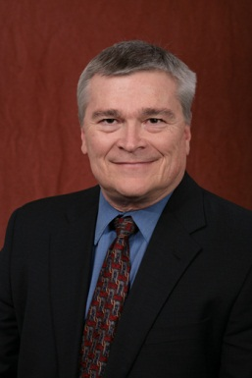
Video Productions:
FLORIDA STATE UNIVERSITY
Office of Human Resources

Slide 60

Contacts
FLORIDA STATE UNIVERSITY
Office of Human Resources
Tobacco Dependence Treatment Services:
University Tobacco Policy:
Lynn M. Vinson
(850)644-6489
lvinson@admin.fsu.edu
Kevin Frentz, Ph.D.
(850)645-4973
kfrentz@admin.fsu.edu

Slide 61
Questions & Answers
FLORIDA STATE UNIVERSITY
Office of Human Resources

Slide 62
Closing Remarks
Renisha Gibbs
FLORIDA STATE UNIVERSITY
Office of Human Resources

